Slide 1

Monkey Bars

Slide 2
IN THEORY
The concept of Market Profile stems from the idea that markets have a form of organization determined by time, price, and volume. Each day, the market will develop a range for the day and a value area, which represents an equilibrium point where there are an equal number of buyers and sellers.
In this area, prices never stay stagnant. They are constantly diverging, and Market Profile records this activity for traders
to interpret.

Slide 3
J. Peter Steidlmayer developed Market Profile in the 1980s in conjunction with the Chicago Board of Trade. Traders who use it say that they get an in-depth understanding of the market, contributing to improved trading. Many factors can be monitored from Market Profile.

Slide 4
Market Profile is not an indicator in the typical sense. It does not provide buy/sell recommendations but acts more like a decision-support tool. It organizes the data so that you can understand who is in control of the market, what is perceived as fair value, and the direction of the price move. It is possible to extract enough information from Market Profile for you to position your trades more
advantageously.

Slide 5
“Market Profile reveals pricing patterns from any market as they develop. By effectively organizing time and price information, it is possible for traders to see which areas the market is accepting and which ones it is rejecting…and adjust their trading styles accordingly.”

Slide 6
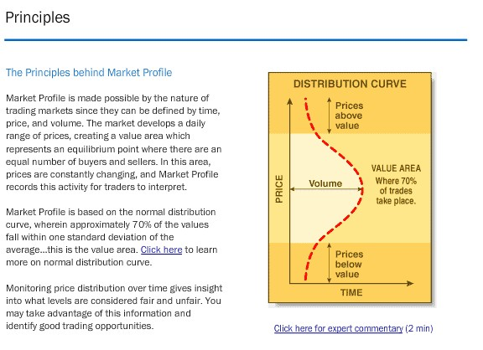

Slide 7
TOS programers developed their version of market profile based on the original concepts with some modifications to adjust for a market that is now open almost 24 hours a day. The original market profile used letters to distinguish a change in period, where monkey bars uses 0-9 and then a color coating scheme with 10 different colors. Lets take a look at a few basic Monkey bar charts the most closely resemble the original market profile concept.

Slide 8
What makes Monkey Bar charts different from other profile charts?
MB uses numbers for each new price traded in a given time per
instead of the letters provided by the exchanges.
Colors are used for every set of 0-9 numbers to help identify the
time and area the market distribution took place. Using colors
also help break up the day into time zones.
Monkey Bars can also be expanded out in a bar chart formation.
This allows a trader to see the distribution in a bar formation along
with the profile studies overlaid on top of it.

Slide 9
Some points to be made when using MB profile charts:
A distribution chart such as MB help you to understand
who is in control of the market. The long term or short
trader.
When the market is in a bell shape formation, it is balanced
and shows the short term traders are in control. They will
trade around the mean or Monkey Bar.
When the market moves to a new area to find value, then it
becomes imbalanced until it begin to distribute outside of the
playground/value area.

Slide 10
Key terms:
The playground
Is the area where 70% of the trading took place for the time chosen.
Monkey Bar
Is where the market traded most throughout the trading time frame
Assigned. It is considered the mean or point of control in other
Profile charts.
TPO
Time price opportunities – each one represent a digit. When the price
Falls into a specified interval within the 1st aggregation period, the interval
Is assigned a number in a digit.
Opening TPO – shows the 1st TPO in the profile. A highlighted square.
Last TPO - The last price of the closing of the profile is pointed out on the right with an arrow
And highlighted price.

Slide 11
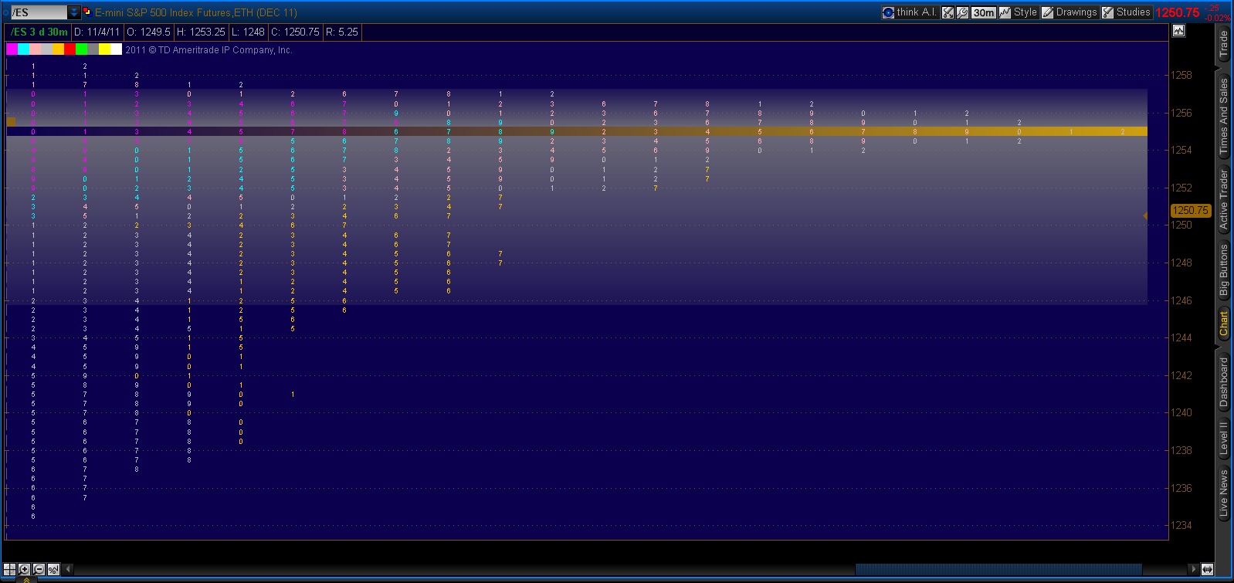

Slide 12
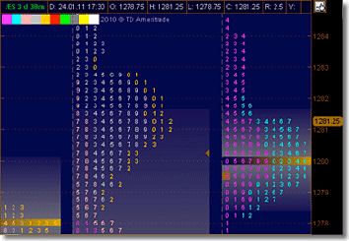
The Monkey Bars chart type displays price action over the time period at specified price levels. The sequence of colors used to distinguish the decades is shown in the upper corner of the chart.

Slide 13
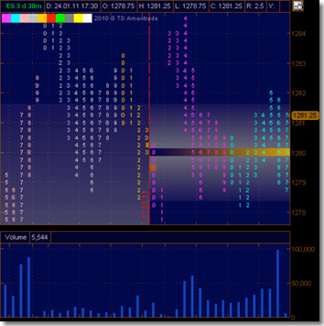
The Monkey Bars
The Monkey Bars Expanded chart type converts regular bars/candles to the Monkey Bars style view. Its algorithm is similar to that of Monkey Bars, but the columns are not collapsed. In contrast to Monkey Bars, the chart does not resemble a bell-shaped curve but actually repeats the regular price action pattern

Slide 14
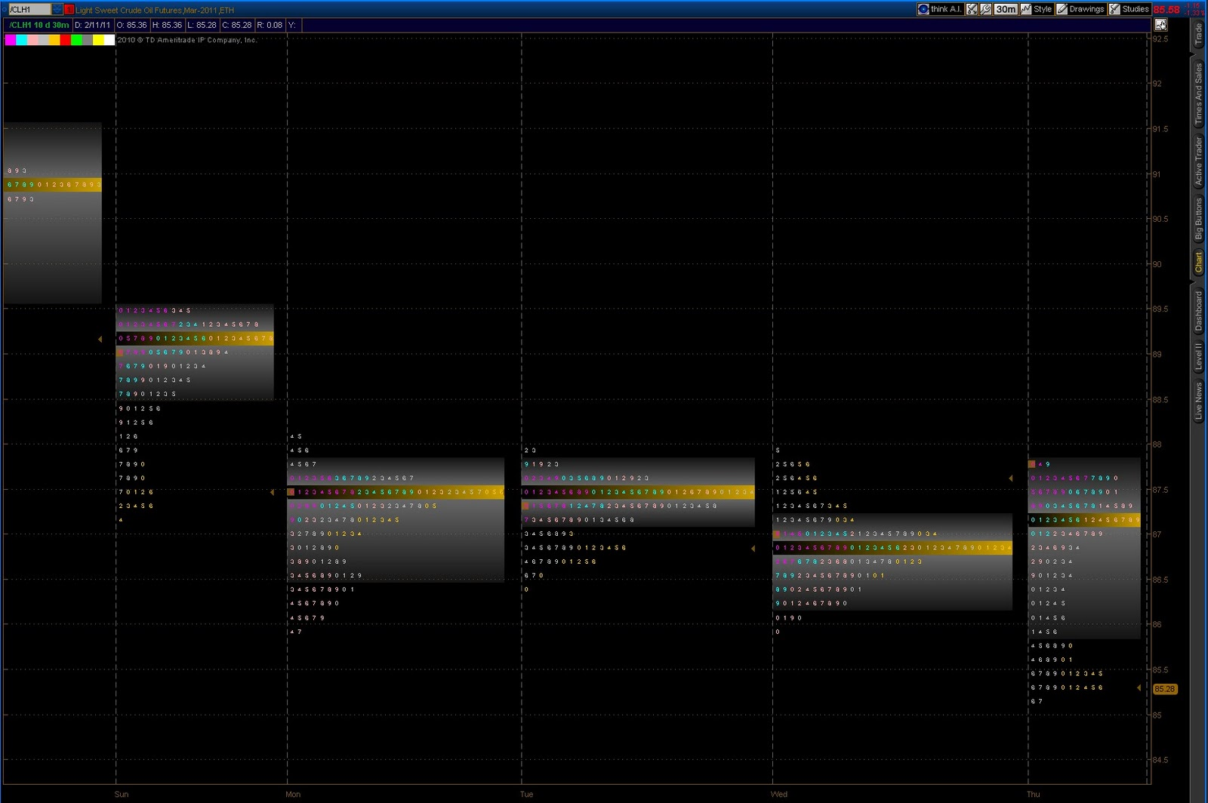

Slide 15
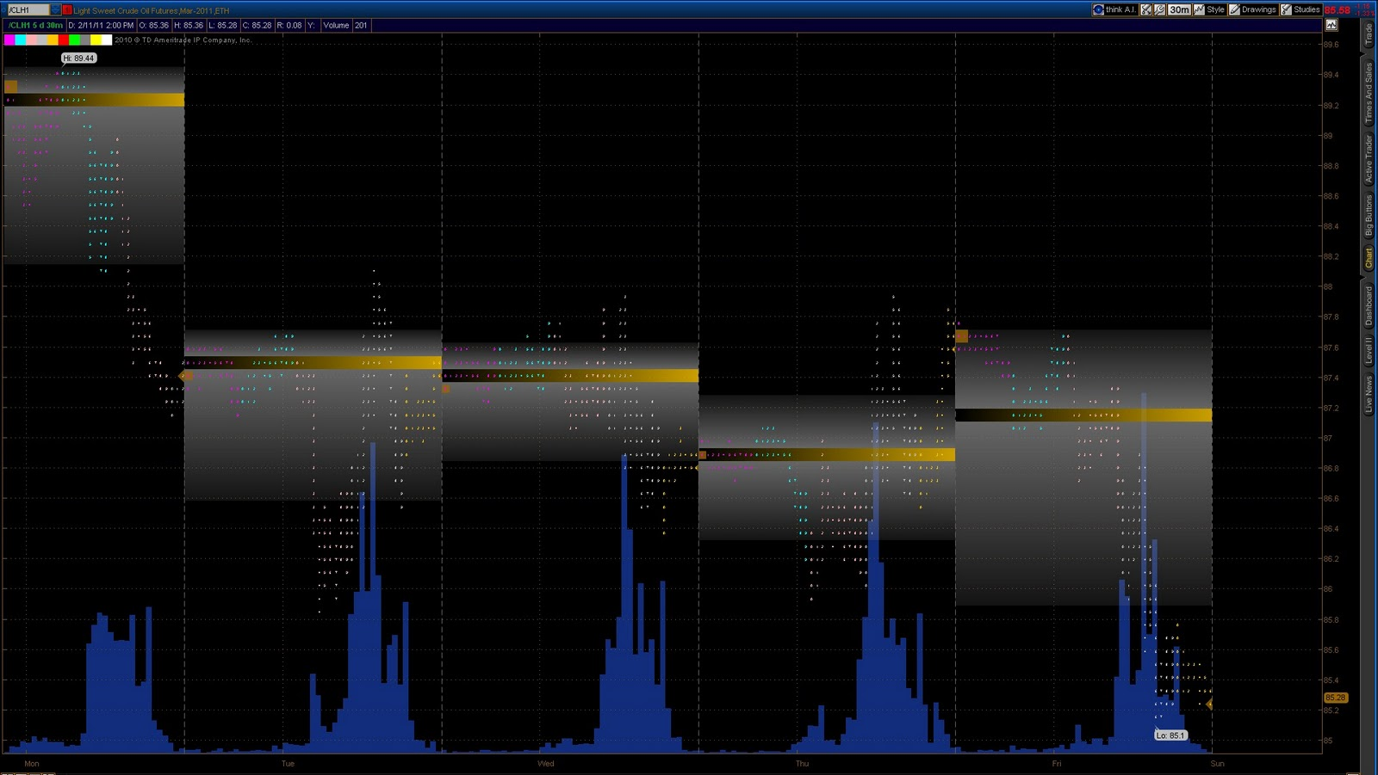
TOS programed it so that if you wanted to you could see the market profile in the form of a bar chart while leaving the value area and point of control on the chart. Also what had never been done before is the ability to overlay studies on the chart as well such as volume.

Slide 16
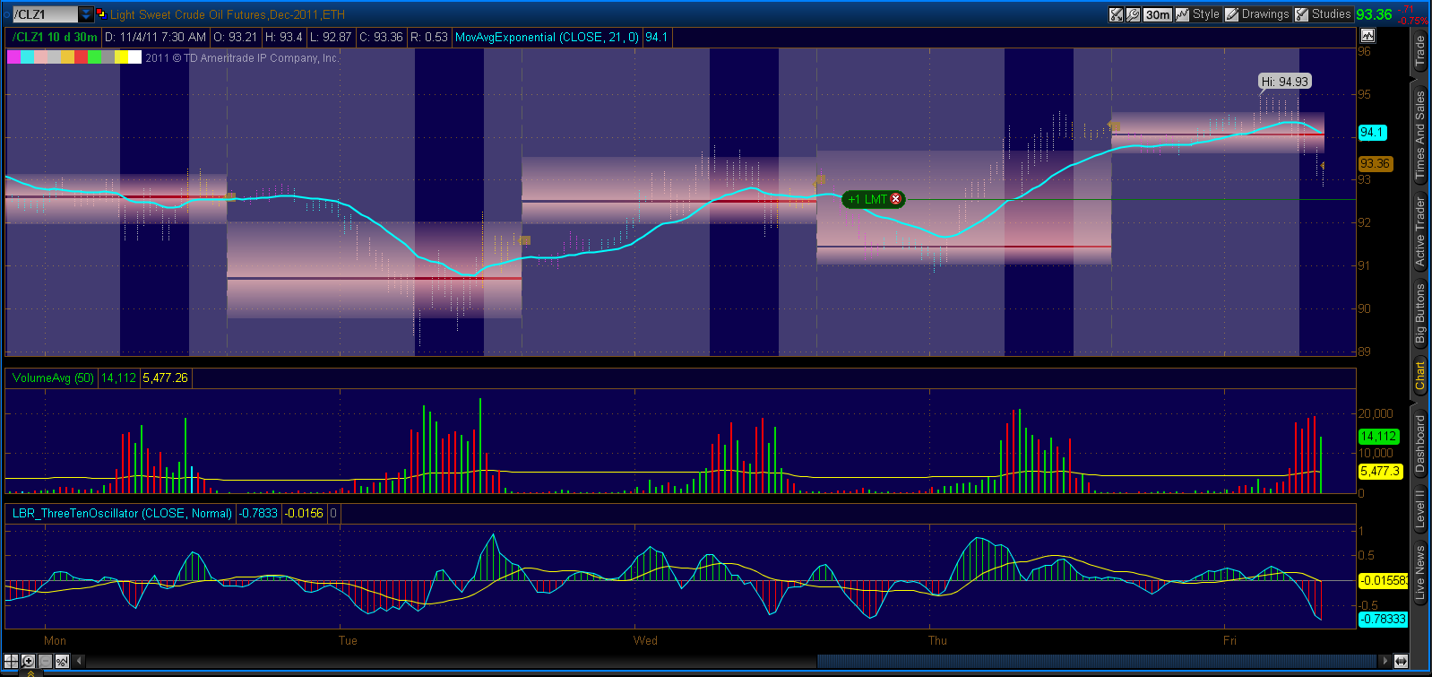

Slide 17
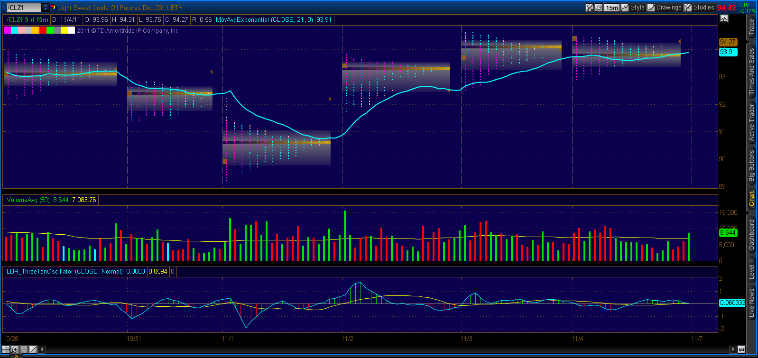

Slide 18
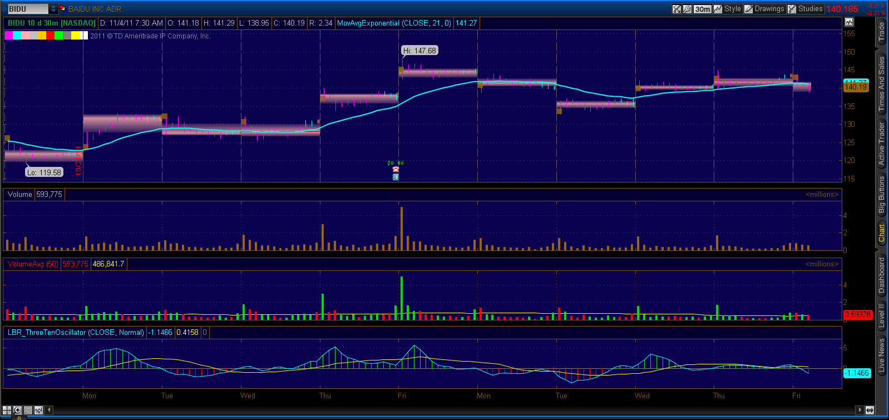

Slide 19
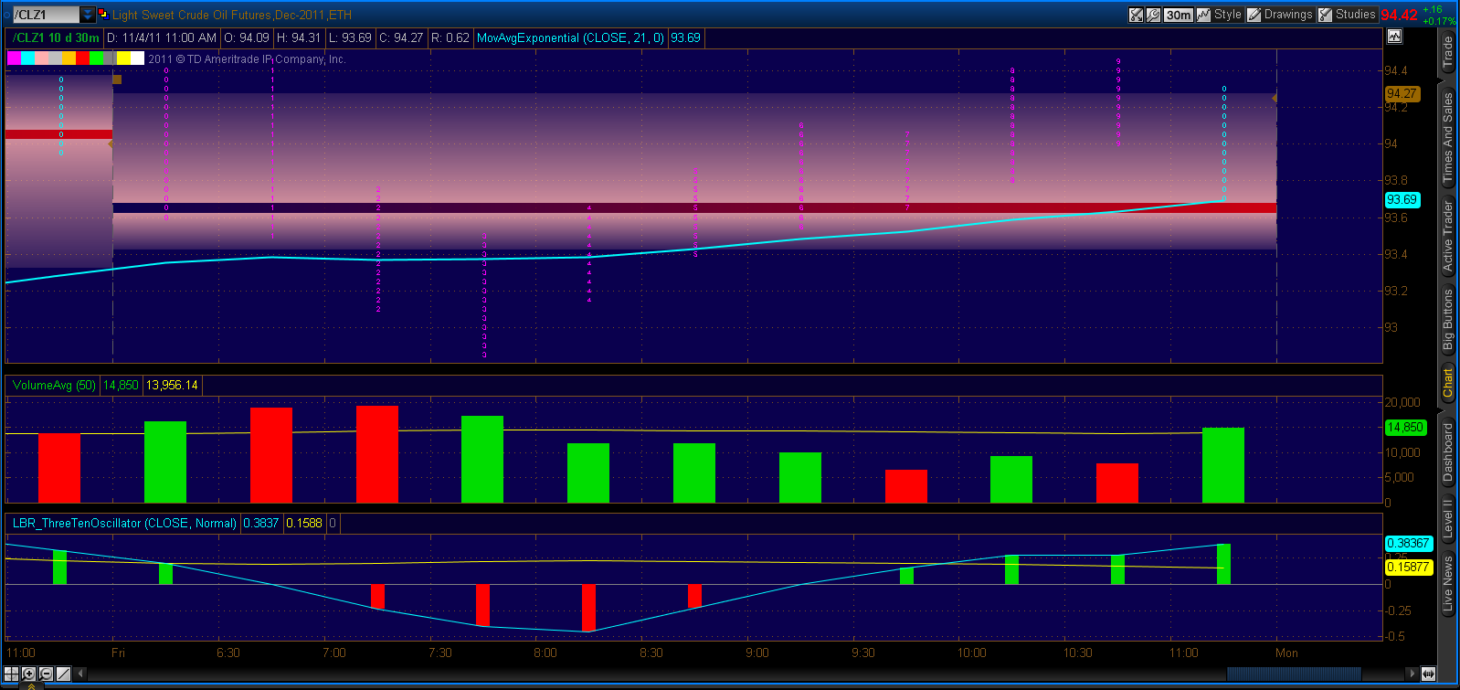

Slide 20
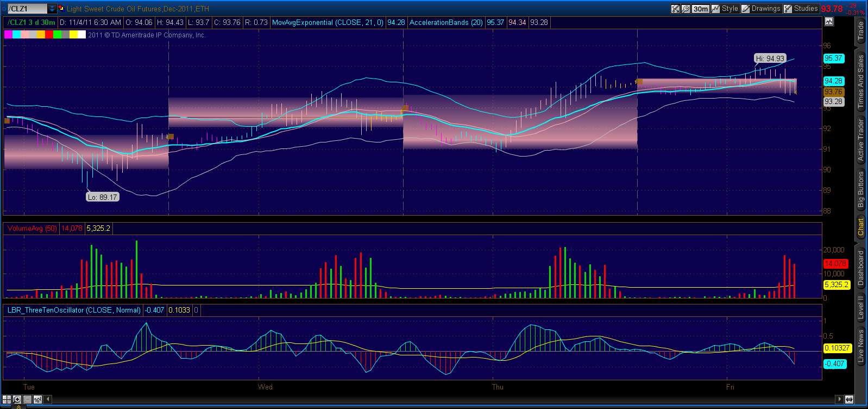

Slide 21
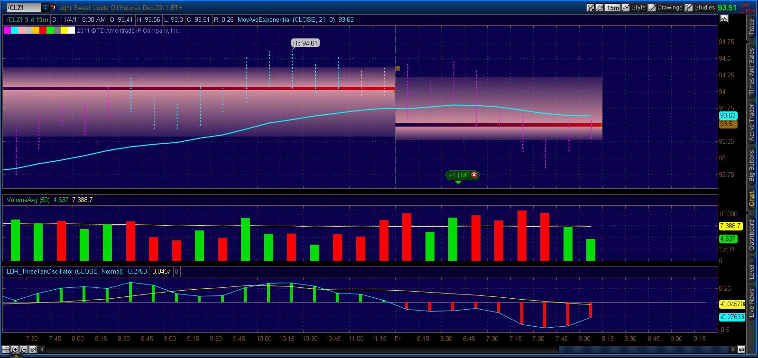

Slide 22
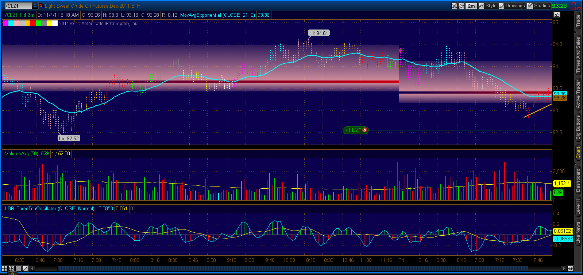

Slide 23
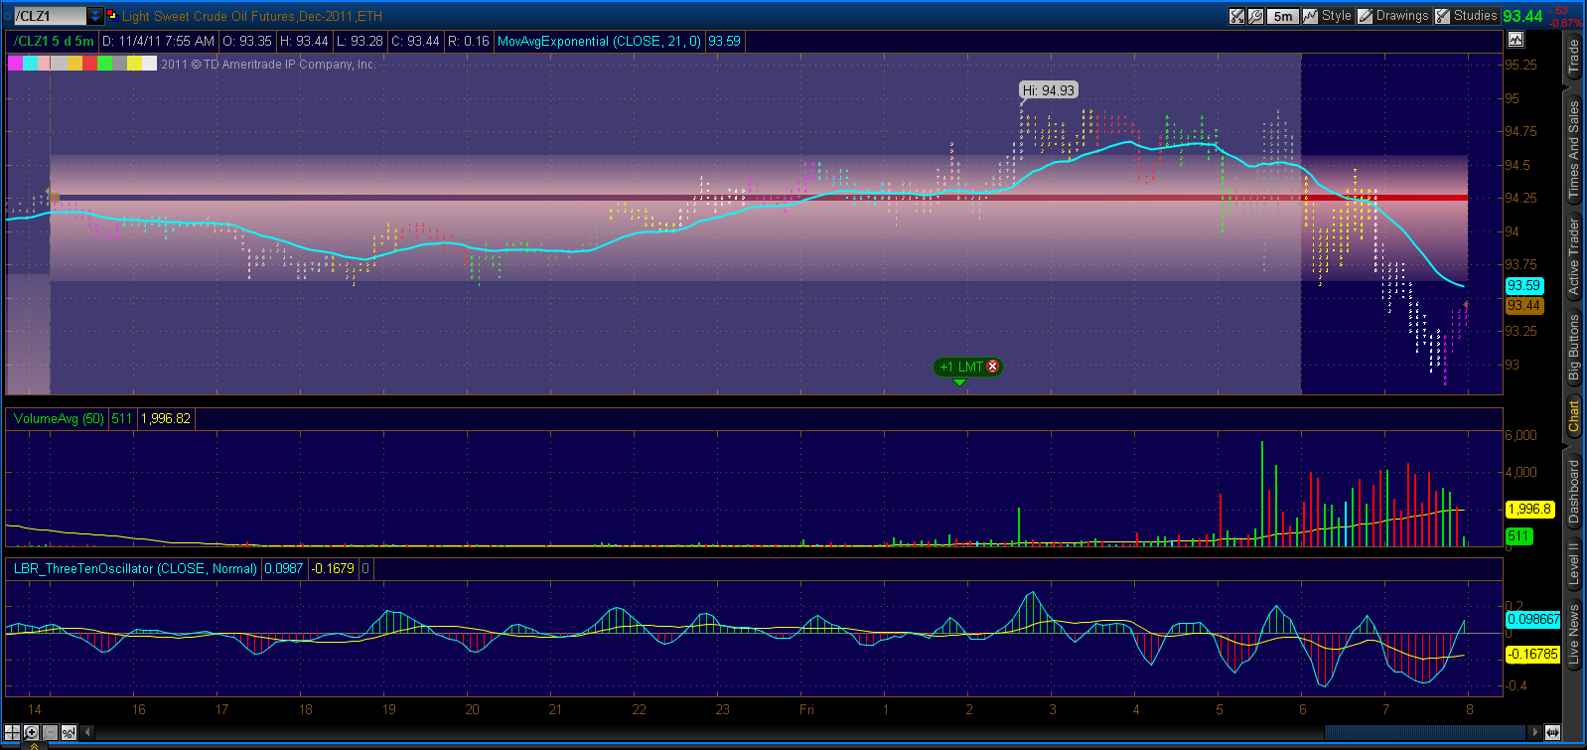

Slide 24
CONCLUSION
Market Profile reveals several factors that provide you with
an idea of the trading activity taking place in the markets.
Monitoring the market action will enable you to determine
the type of day that is developing, whether a price trend has started, what the value area is, the type of activity (initiative or responsive) taking place, whether the activity is continuing or changing from the previous day, and whether the market is trending or bracketing. Combining Market Profile with indicators such as moving averages can help you create a successful trading strategy.

