Slide 1
What’s your “edge”?
OC Traders
Rick Edwards
5/21/11

Slide 2
What is an “Edge”?
Anything that tilts the odds of making profit in your favor
  For Traders, edges affect one or more of the following:
    Improves Winning percentage (W)
      Also reduces losing percentage (L)
    Improves average amount won (P)
    Reduces average amount lost (R)
  Improves Expectancy
    E = WP - L
    R

Slide 3
Price Based Examples
Putting Resistance/Support between your entry and your stop
  Buy on Bounce
  Buy on Breakout above resistance
Using Price patterns to identify exit points
  Head and Shoulders
  Cup and Handle
  Double-bottom
  Ascending Triangle, etc.
Candlestick Patterns
  Topping Tails/Hammers
  Engulfing Patterns

Slide 4
Indicator Based Examples
Indicators filter price/volume data
  Moving Averages
  RSI
  PPS
  ADX/DMI
  Bollinger/Keltner Bands
  MACD
  Stochastics
  CCI
  . . .

Slide 5
Trend Based Example
Follow the trend
  “The trend is your friend . . . ‘til the end . . . when it bends “
    Up Trend = Higher Highs/Higher Lows
    Down Trend = Lower Highs/Lower Lows
Buy pullbacks
  Fibonacci Retracements
  Williams %R

Slide 6
Instrument Based Examples
Options
  Time Decay (Theta)
  Implied Volatility
  Delta Scaling
Leverage
  2x, 3x ETF’s
  Options
  Futures
  Forex

Slide 7
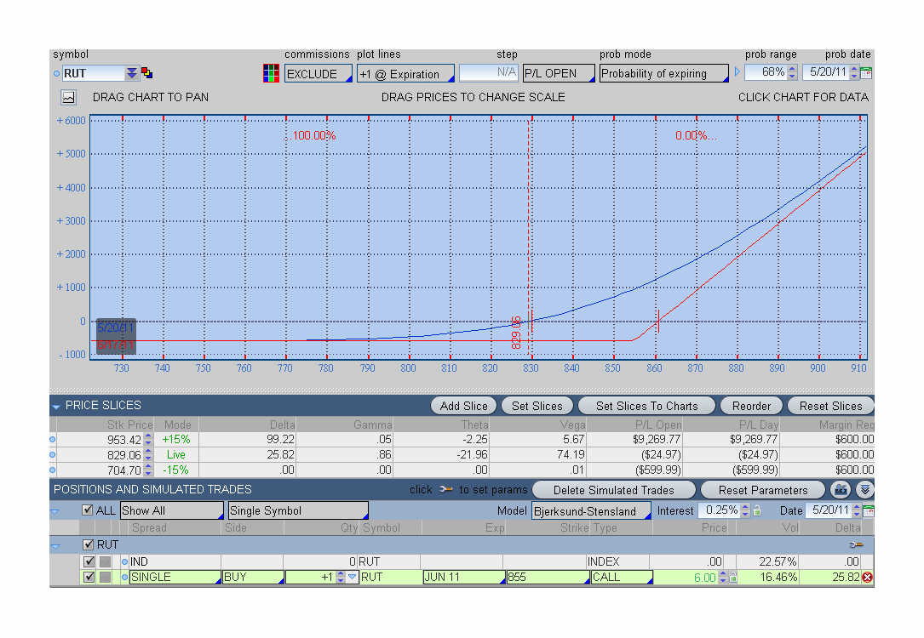
OTM Option--Delta Scaling
Automatic Scaling in/out as price/delta moves.

Slide 8
System Based Examples
Position Sizing
Trailing Stops
Adjusting/Rolling Options
Delta Neutral Strategies
Preparation
  Research
  Earnings
  News
  Fed Announcements

Slide 9
The “Investools” System
Entry Rule
  Three Green Arrows on an uptrending stock
Exit Rule
  Three Red Arrows and a break of support
Can you identify all of the “edges”?

Slide 10
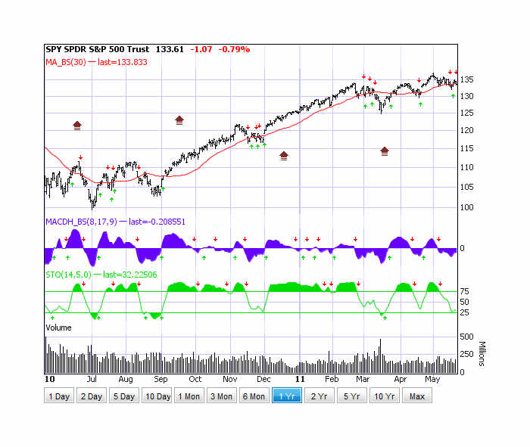
The “Investools” System
Entry

Slide 11
The “Investools” System
Entry
Exit

Slide 12
The “Investools” System
Higher High/Higher Low
Break of Ascending Triangle

Slide 13
The “Investools” System
Higher High/Higher Low
Break of Ascending Triangle
MACD Histogram
Positive Momentum

Slide 14
The “Investools” System
Higher High/Higher Low
Break of Ascending Triangle
Price Break above 30 DMA
MACD Histogram
Positive Momentum
Stochastics Moving
Out of “Oversold” Area

Slide 15
The “Investools” System
Edges
  Uptrend (Higher Highs/Lows)
    Improves Win % (W)?
    Improves Avg Amount Won (P)?
  Break of price pattern
    Ascending Triangle
      Helpful in setting price targets
        Improves Avg Amount Won (P)?
        Improves Win % (W)?
  MACD Histogram crossing zero
    Based on Moving Average crossover
      Confirms bullish momentum
      Improves Win %?
  Reducing Avg amount Lost (R)
    Proper Position Sizing
    Appropriately set stops
    Hedge

Slide 16
Summary
Plan your trade . . . trade your plan
  Know what your “edges” are and what they affect
    Win rate/Loss rate
    Average Win Amount
    Average Loss Amount
Write it down
Follow it!
Measure it
Improve it!

