Slide 1
Scaling in and
Scaling out
Hare Krishna Mitra
OC Traders

Slide 2
TRADING DISCLAIMER
All TRADING involves high risk and YOU can LOSE a substantial amount of money, no matter what method you use. All trading involves high risk; past performance is not necessarily indicative of future results.
Commission Rule 4.41(b)(1)(I) hypothetical or simulated performance results have certain inherent limitations. Unlike an actual performance record, simulated results do not represent actual trading. Also, since the trades have not actually been executed, the results may have under- or over-compensated for the impact, if any, of certain market factors, such as lack of liquidity. Simulated trading programs in general are also subject to the fact that they are designed with the benefit of hindsight. No representation is being made that any account will or is likely to achieve profits or losses similar to those shown.

Slide 3
Definition
Scaling In: Adding to your winning position at appropriate price levels bucking on the trend to increase profitability.
It is also called Pyramiding
Scaling Out: Taking partial profits at different price levels to reduce risk

Slide 4
Types of Entries & Exits
All In and All out
All In and Scale Out
Scale In and All Out
Scale In and Scale Out

Slide 5
All In and All Out
Example: E-mini S&P
Profit=3x10x$50=$1500
Seller Concentration Area
3 cts. out
10 pts.
3 cts. in
Buyer Concentration Area
3 pts. Stop loss
Loss=3x3x$50=$450

Slide 6
All In and Scale Out
Example: E-mini S&P
Profit=19x$50=$950
Seller Concentration Area
3rd ct. out
10 pts.
2nd ct. out with 6pts. profit
1st ct. out with 3pts. profit
3 cts. in
Buyer Concentration Area
3 pts. Stop loss
Loss=3x3x$50=$450

Slide 7
Scale In and All Out
Example: E-mini S&P
Profit=21x$50=$1050
Seller Concentration Area
3 cts. out
10 pts.
3rd ct. in
2nd ct. in
3 cts. in
Buyer Concentration Area
* 3 pts. Initial Stop loss
**Loss=1x3x$50=$150
* Trailing Stop is needed
** This is not the worst case loss

Slide 8
Special Type of Scaling In
You can strategically add to your losing position (in contrary to conventional wisdom) to fine tune your entry point (Beginners, please don’t confuse it with doubling down)
You can strategically anticipate a market move (It can be considered as reacting proactively)

Slide 9
Special Scale In and All Out
Example: Fine Tuning Entry
Profit=2x11x$50=$1100
Seller Concentration Area
2 cts. out
10 pts.
1st ct. in
3 pts. Stop loss
2nd ct. in
1 pt. Stop loss
Loss=2x2x$50=$200

Slide 10
Special Scaling In
Example: Fine Tuning Entry
1 pt. Stop loss
Anticipating that it will create a Double Top
3 pts. Stop loss
2nd ct. in
1st ct. in
Market is here
Anticipating that it will fail to take the previous swing high

Slide 11
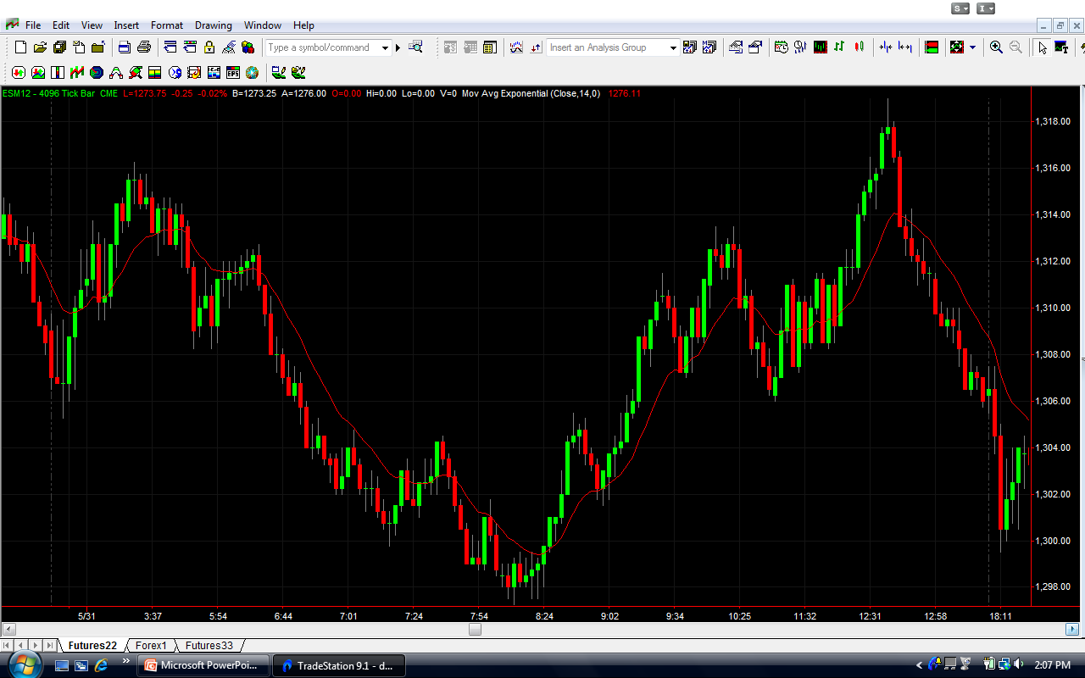
ES(Intra-day)

Slide 12
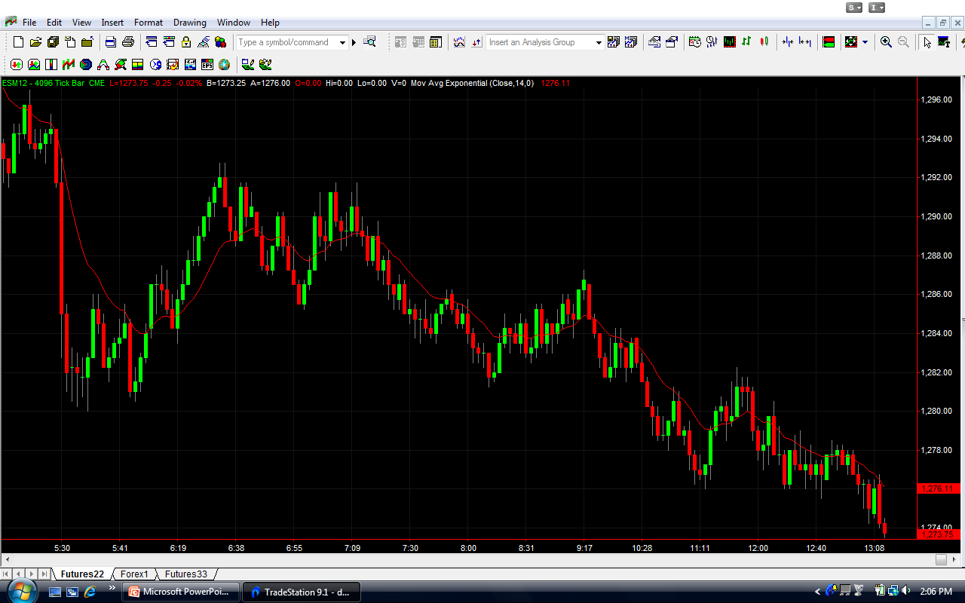
ES (Intra-day)

Slide 13
Conclusion
Different variations of Scale In and Scale out can be deployed depending on market conditions
There is no single best formula because the market is always changing.
Never forget to use stops

Slide 14
Many Happy
Scale in & Scale out!

