Slide 1
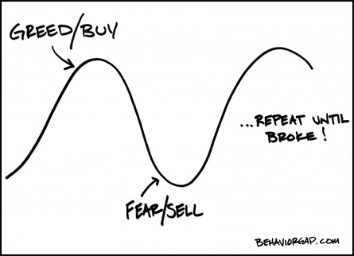

Slide 2
Tell Me And I Will forget
Show Me And I Will Remember
Involve Me And I Will Understand
Aristotle

Slide 3
Odds, Sods
&
Market “Tells”
JC Hersh

Slide 4
Relative Strength
Use To Compare Underlying
To Indices Or Other Underlying
Located In “Studies” within TOS Charts

Slide 5
Volume Profile
Displays Volume By Price
Located In “Studies” within TOS Charts

Slide 6
Point & Figure Charts http://stockcharts.com/support/pnfcharts.html
Price Chart That Ignores Time
Thomas Dorsey – P & F Pioneer
Available at StockCharts.com

Slide 7
Bullish Percent Index
http://stockcharts.com/symsearch/?BULLISH%20PERCENT
http://support.stockcharts.com/forums/30077/entries/21293

Slide 8
VIX vs. VXV
VIX – Current Volatility
VXV – Volatility Next 3 Months
VXV-VIX

Slide 9
http://stockcharts.com/school/doku.php?id=chart_school:chart_analysis:pnf_charts http://dorseywright.com/cgi-bin/foxweb.exe/fwuniv?partner= http://stockcharts.com/symsearch/?BULLISH%20PERCENT http://support.stockcharts.com/forums/30077/entries/21293 http://stockcharts.com/school/doku.php?id=chart_school:technical_indicators:bullish_percent_inde
Reference Links

