Slide 1

Money Management: Key to 90% of Gains
By Ken Hodor
10/19/13

Slide 2
Disclaimer
This analysis is for illustrative purposes. Your performance might vary.
The key “take away” is to better understand money management techniques of one of the best traders of our day.

Slide 3
Trading E-mini S&P
Larry Williams Style
Discretionary trading beats Automated trading
Money Management is key (90% of trading)
$10,000 capital per contract
  TradeStation Margin requirement = $3,800
$2,300 stoploss per contract

Slide 4
Comparison using $20,000 capital
Buy and Hold
Trading fixed contracts
Trading with Money Management on E-mini S&P

Slide 5
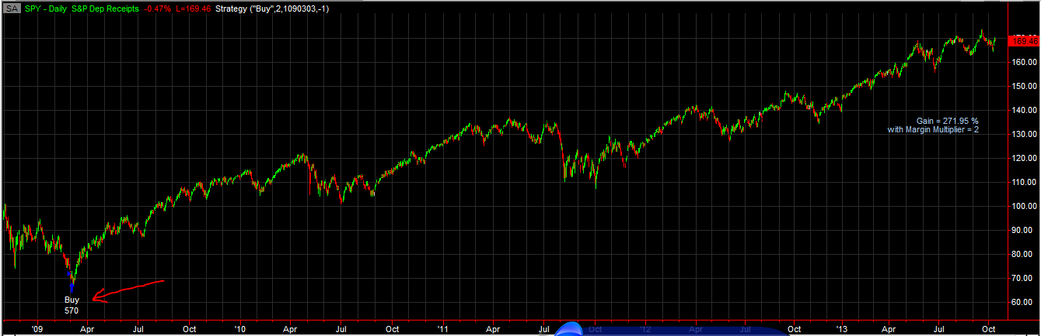
SPY Buy and Hold
50% margin ➔ margin multiplier = 2
2.8X gain

Slide 6
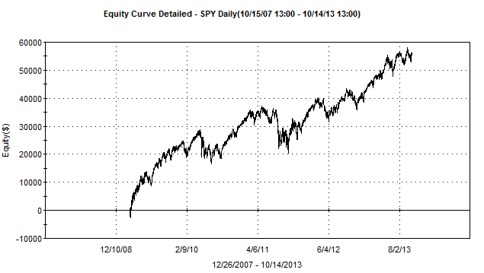
SPY Buy and Hold Equity

Slide 7
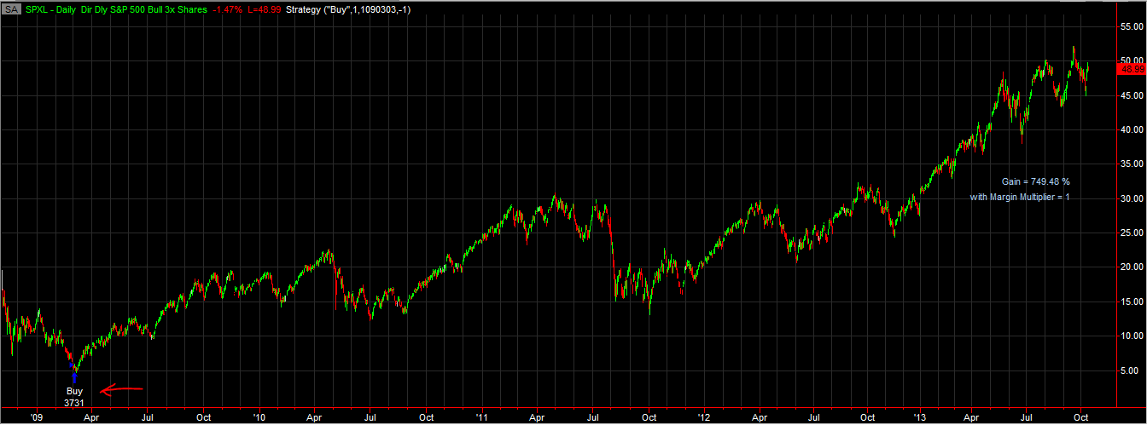
SPXL (Triple ETF) Buy and Hold
Margin Multiplier 1 (no Margin)
8.1X gain

Slide 8
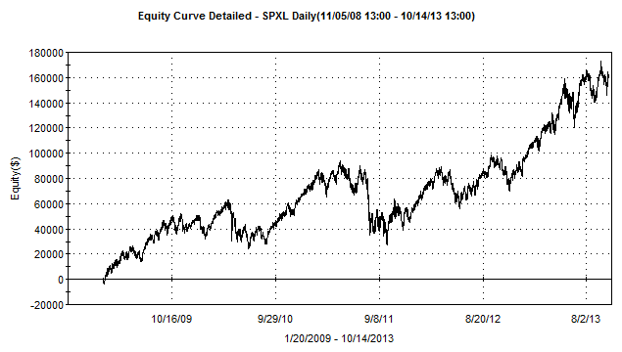
SPXL (Triple ETF) Buy and Hold

Slide 9
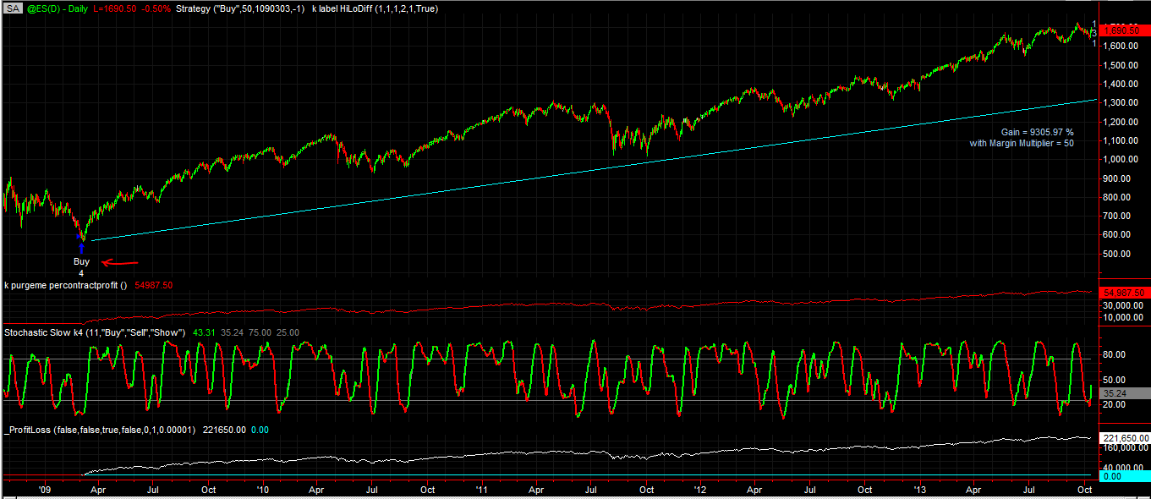
Emini S&P Buy and Hold
Margin Multiplier = 50
11X gain

Slide 10
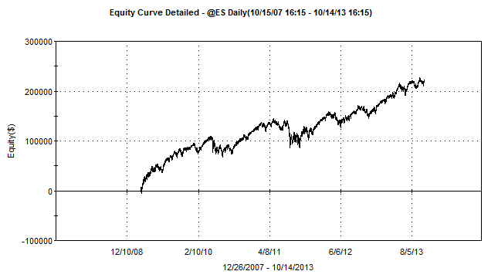
E-mini S&P Buy and Hold

Slide 11
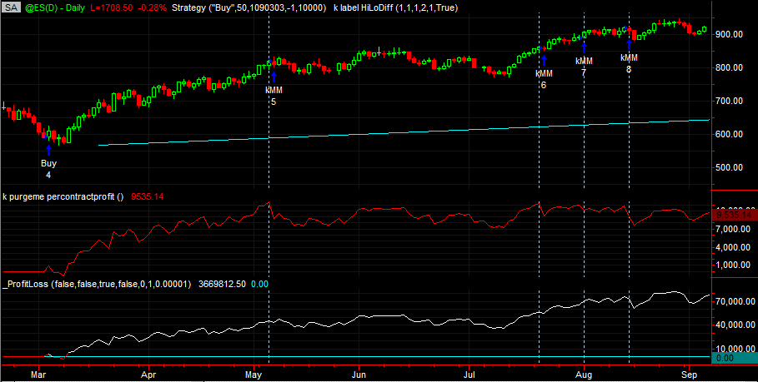
E-mini Buy and Hold + 10K contracts

Slide 12
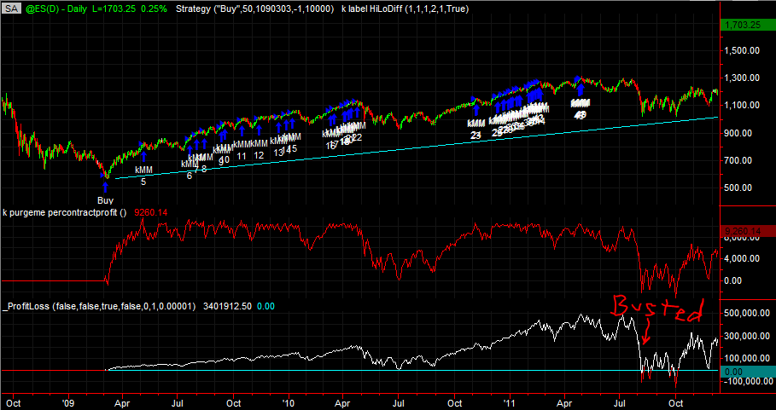
E-mini S&P Buy and Hold + 10K contracts
BUSTED!
Increase contacts when $10K excess capital
Notes:
Simply adding contracts each time there is $10K of excess capital does not work. When there is a pull back you run the risk of going bust. Here is a case and point.

Slide 13
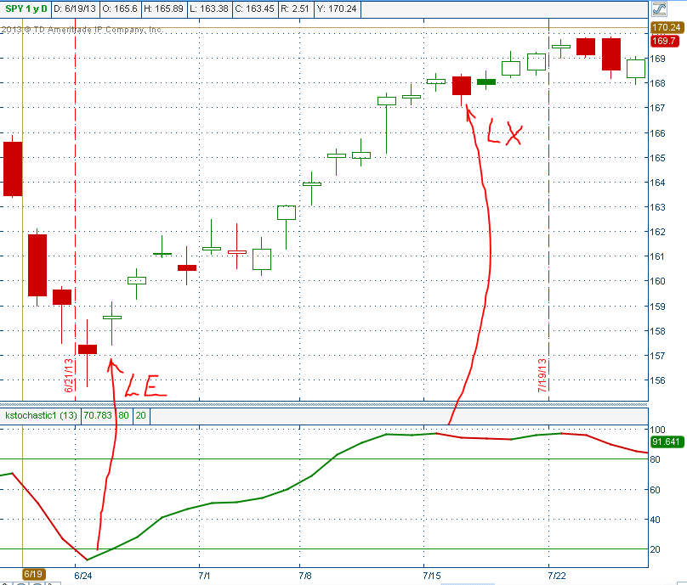
KStochastic

Slide 14
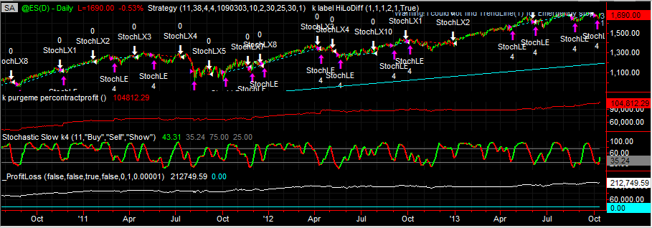
Emini S&P Trade Fixed Contracts
Margin Multiplier 50
10.4X Gain

Slide 15
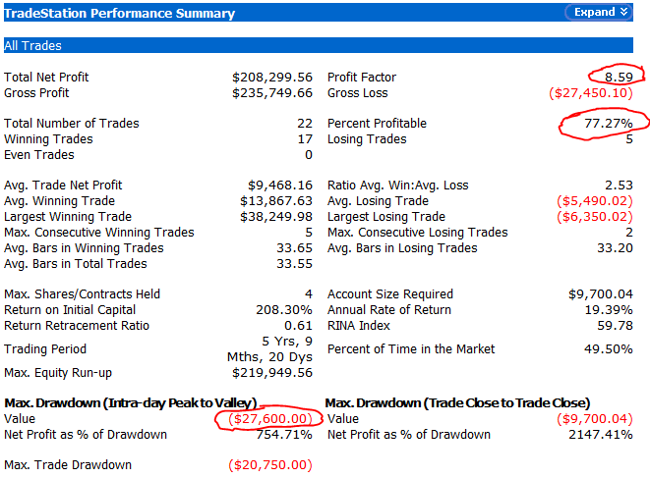
E-mini S&P Trading Fixed Contracts using the Stochastic

Slide 16
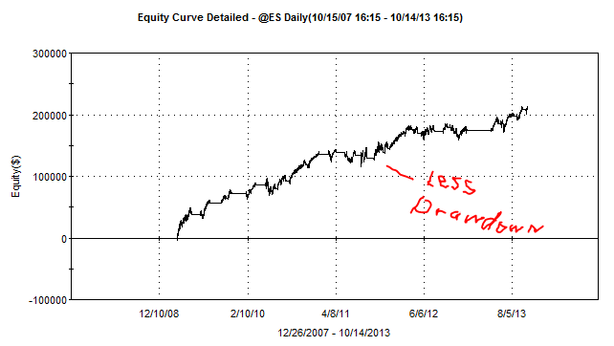
E-Mini Trade Fixed Contracts

Slide 17
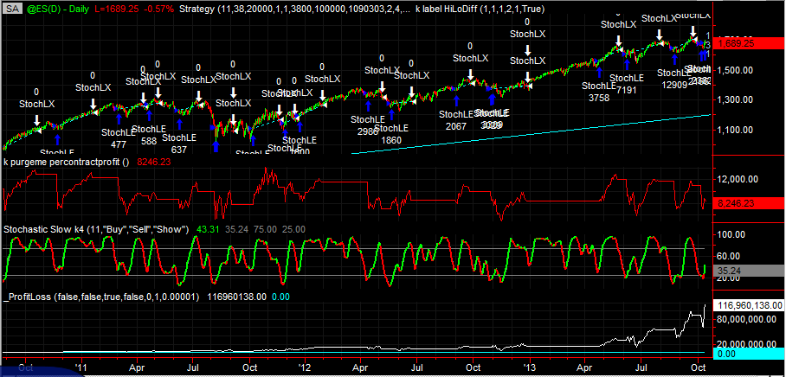
E-mini S&P Trade with
Money Management
$10K per contract

Slide 18
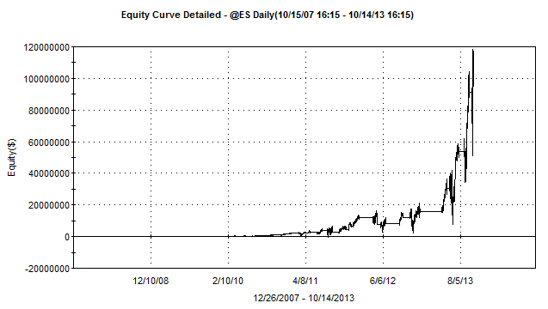
E-mini S&P Larry Williams
Money Management Equity chart
$10K per contract

Slide 19
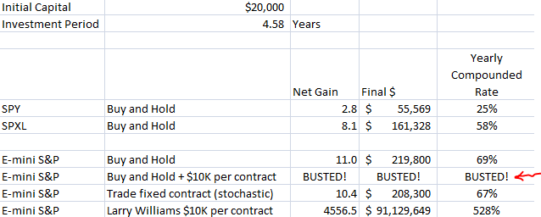
Summary comparison
Notes:
Looking at the buy and hold E-mini vs the buy and hold with $10K per contract indicates the strategy goes “bust.” Your drawdown takes you out of the market and you get a serious margin call.
In this chart you can see buy and hold returns more than using the stochastic to control the entries and exits of the positions. However, for the lower return you get a reduction in the drawdown.
As shown in the bottom line, using the stochastic to control entries and exits combined with effective money management we get tremendous returns on our capital. No wonder Larry Williams is so successful following his trading and money management rules.

Slide 20
References
XSProfits.com presentations by Ken Hodor
  Stochastic Trading
    4/18/09 Purple Crayon Trading
    8/21/10
      Explores all aspect of the Stochastic and compares it to other techniques—MACD, CCI, Moving average, etc.
      ThinkScript
      Stochastic Study
  Money Management
    11/20/10 by Initial Money Management Presentation
    12/18/10 Follow-up to November meeting

Slide 21
Conclusion
The gains achieved by successful money management are more than 10X that of poor money management
$91,129,000 vs $208,000

