Slide 1
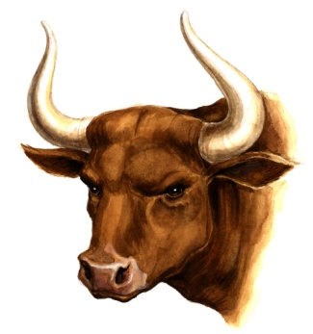

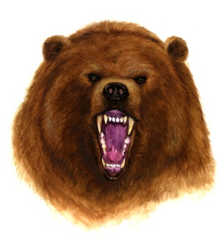
Markets and Airplanes
Steve Alexander
Skype: stev.alex
619-800-1154

Slide 2
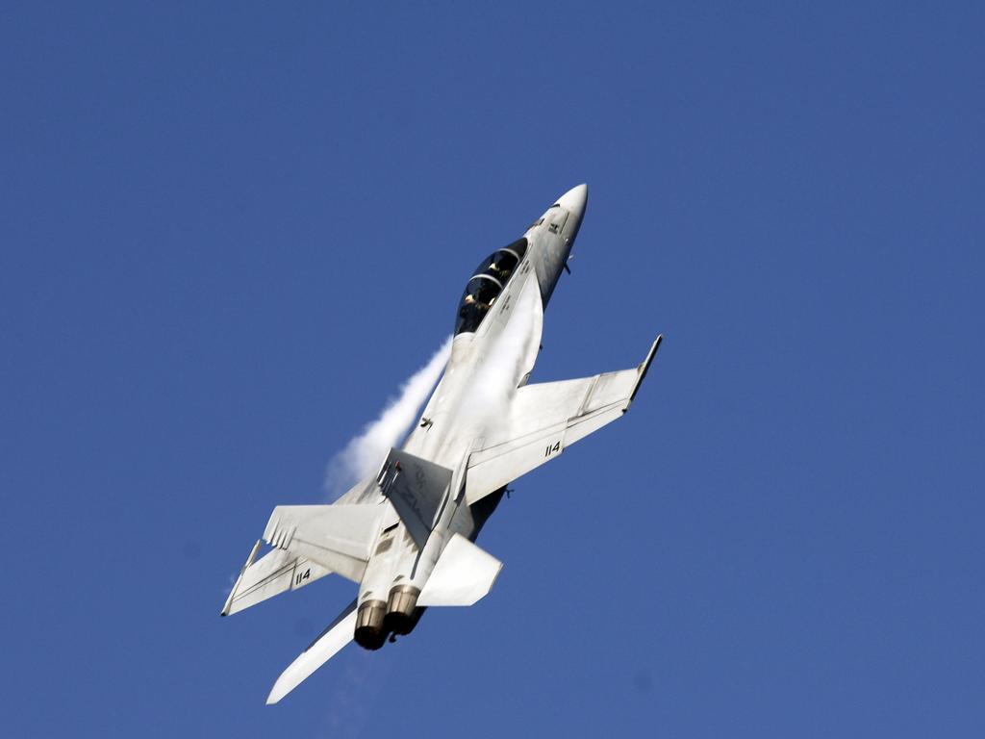
They go up;

Slide 3

They go down;

Slide 4
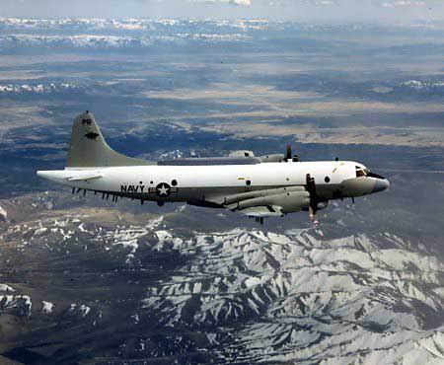
and they go sideways.

Slide 5
When they go up

Slide 6
And when they go down,

Slide 7
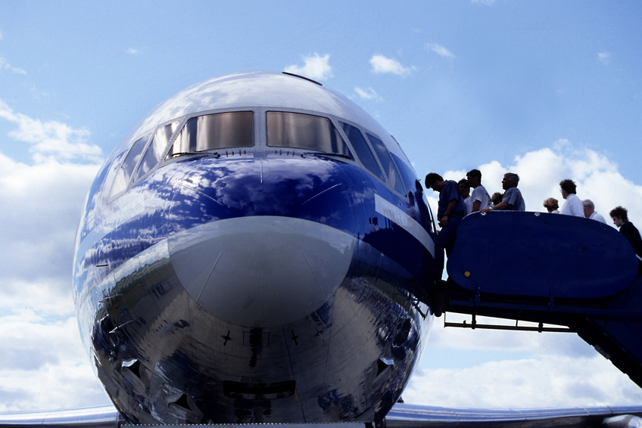
jump aboard and ride!

Slide 8
When they go sideways,

Slide 9

Relax. Have a cup of coffee.
You may have to wait a few days...or weeks.

Slide 10
Take up golf,

Slide 11
or knitting.

Slide 12
Play with your grandkids.

Slide 13
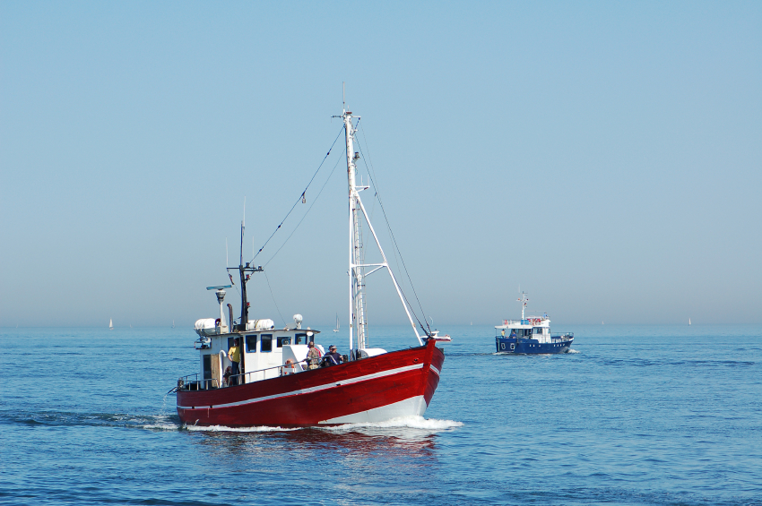
Go fishing.

Slide 14
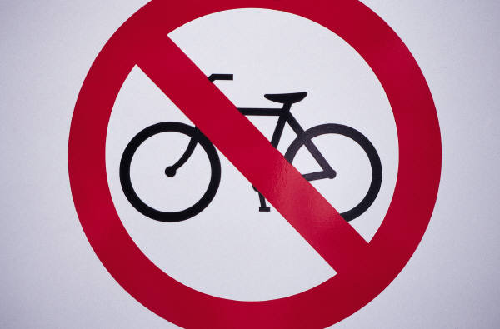
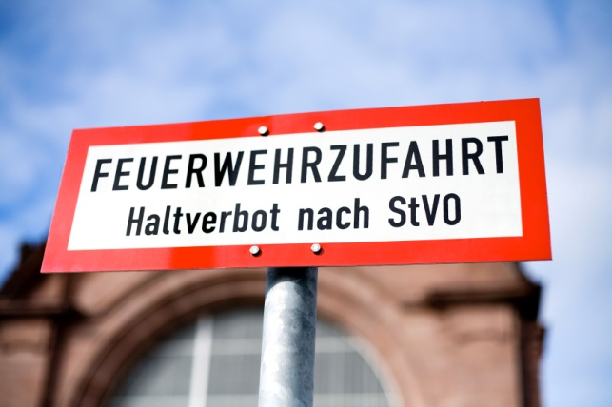

But do not trade!

Slide 15
OK – so you’re gonna trade in a flat market, anyway.
In their world, your good advice is noise.
Under carefully controlled conditions, accounting for all variables, people will do as they damn well please.
Mind your own business!

Slide 16
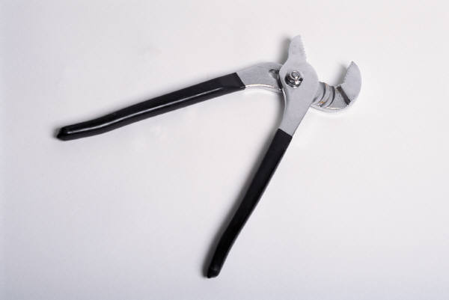
The market is in a channel...

Slide 17

you’re bored,

Slide 18
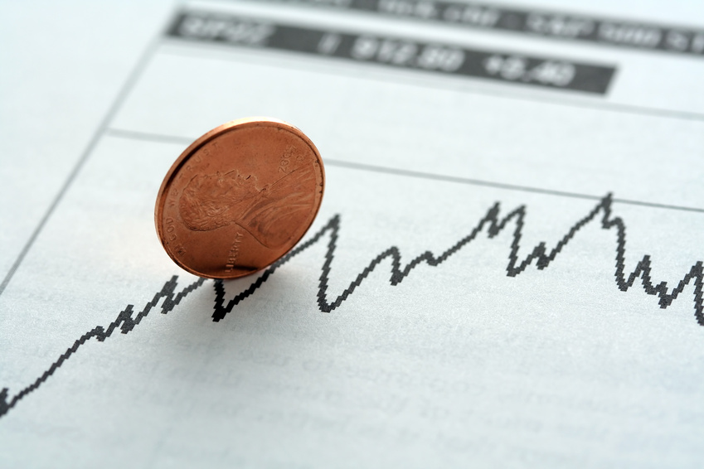
and you are going to trade...

Slide 19


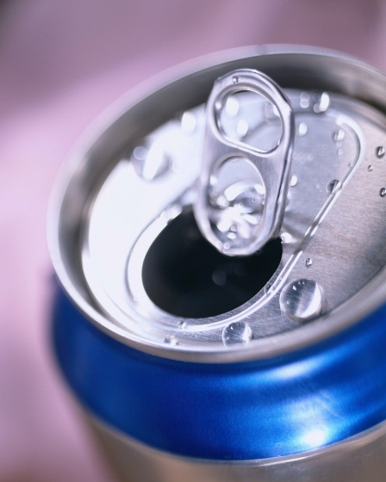
Try this. Short the tops.

Slide 20
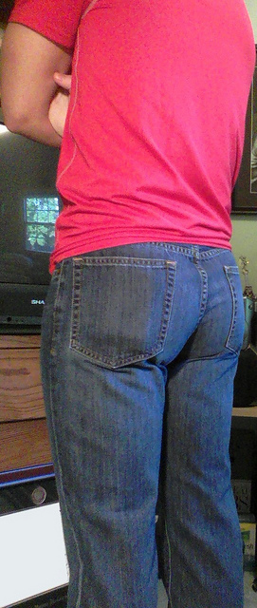
and buy the bottoms.

Slide 21
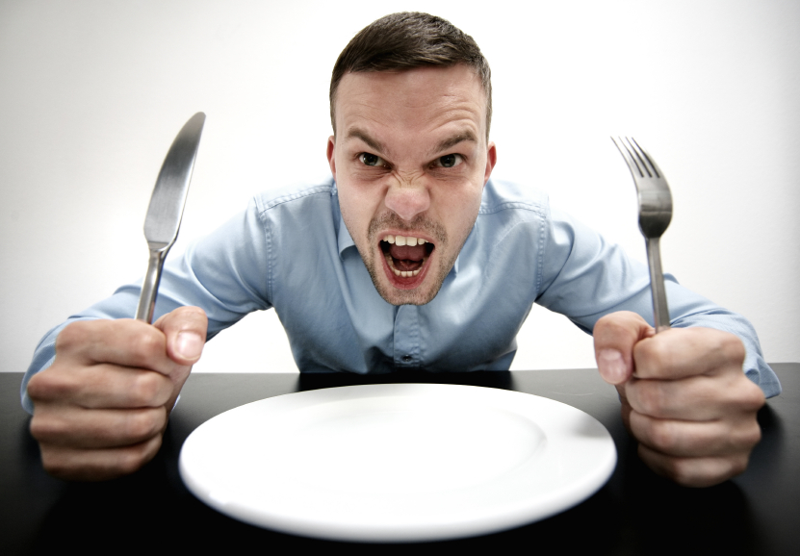
and wait for the next trend.

Slide 22
While you are waiting, consider
There are only four possibilities for a trade
BIG LOSS
Small loss
BIG GAIN
Small gain
Three of those are OK. Only one is really bad. Eliminate BIG LOSSES, and you’ll be a happy trader.

Slide 23
Big Loss

Slide 24




Slide 25
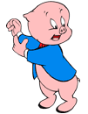
That’s all Folks!
Steve Alexander
stev.alex@gmail.com

