Slide 1

Low Prob RUT Iron Condor
by
Neil Gillis
March 26, 2011

Slide 2
Disclaimer
Options involve substantial risk and are not suitable for everyone.
I am not a professional trader.
This presentation is not intended to replace individual research and your personal decision to act or not to act on anything presented.
This presentation is for information only and is not a replacement for licensed investment advice.
Or, to plagiarize Marty Nohe, “If something bad happens as a result of action taken based upon information presented, it ain’t my fault and you can’t sue me!”

Slide 3
Background
Lost over 50% of my 401K value in 2000-02
In early 2003 joined an Investment Group which used Motley Fool techniques to buy and sell stocks. Left group in 2004.
Kept reading about investing & attended Investools Seminar in Sep ’08 (days before big crash began)
Attended numerous free TOS seminars (Don Kaufman) & began investing in Stocks, Naked Puts, Covered Calls & Hi-Prob Condors in Dec ’08
Joined Sheridan Options Mentoring Mar ’09 to learn how to adjust option positions
Began using SOM techniques in Sep ‘09
Notes:
Road Enron from peak to 0! Did make profits on other investments but I found it difficult to work in a group of 10 or 12 that needed consensus before making a move.
First Investools seminar was the week before the big crash!

Slide 4
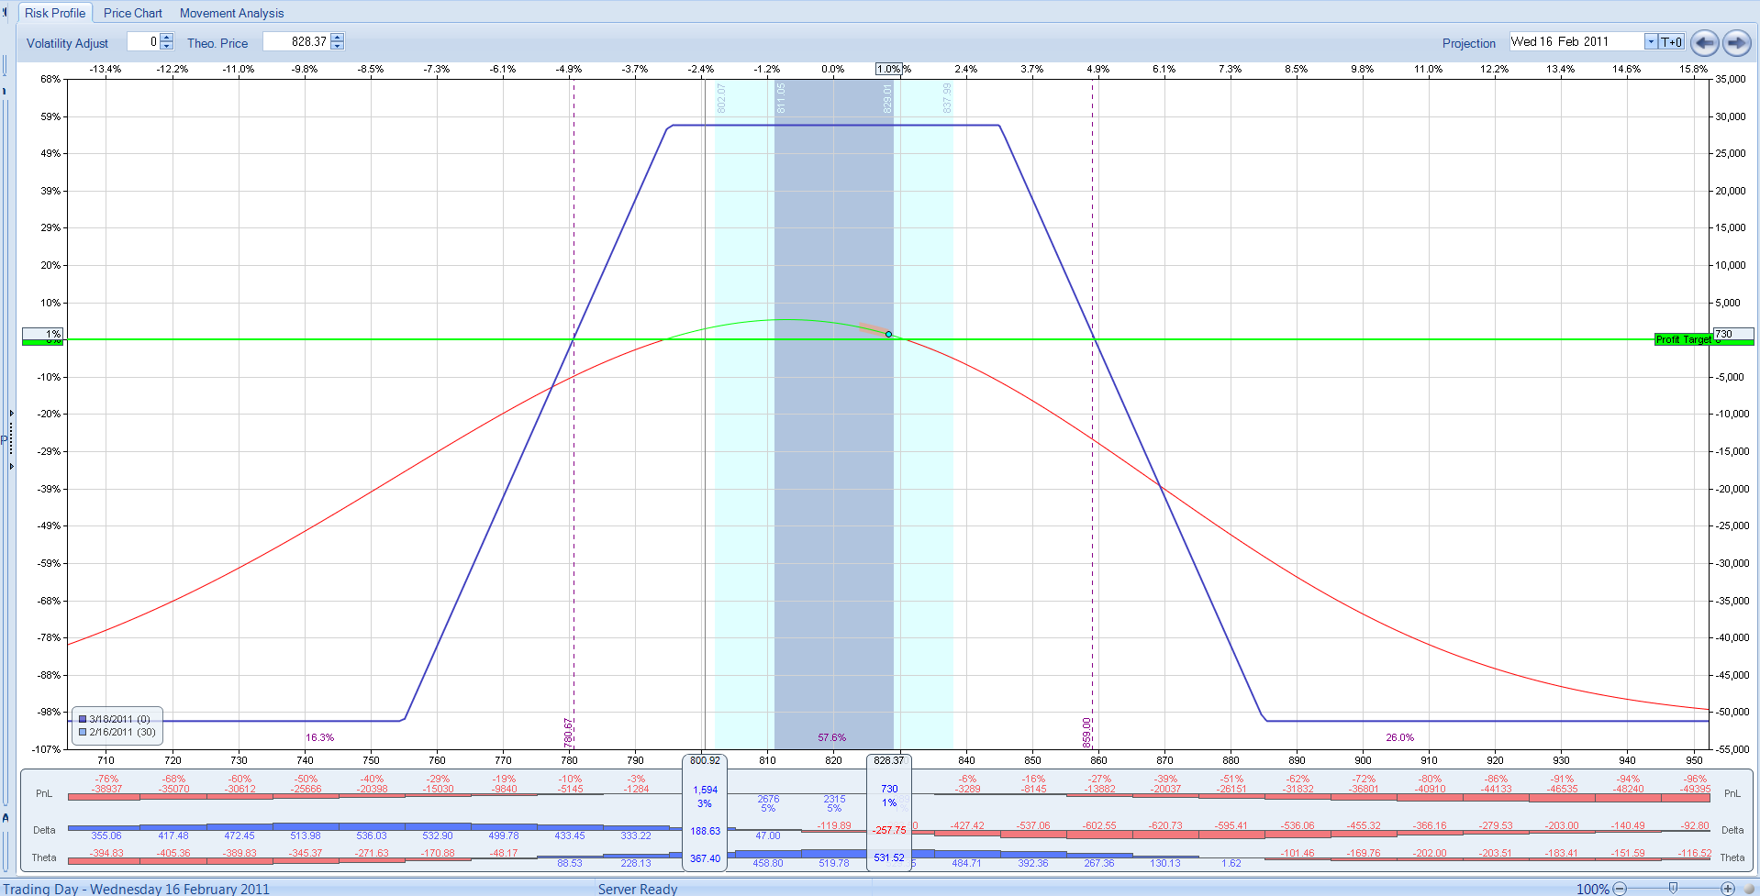
Iron Condor
Consists of Call & Put Credit Spreads and visually looks like this:

Slide 5
My Strategy - Guidelines
Enter 37 Days to Expiration
50 Points between Short Strikes
40 Point Wings between Short & Long Strikes
Usually start with negative Deltas & use Long Calls to cut Deltas in half & flatten T+0 Curve
Use Long Puts as insurance against big, fast move down
Know your goals (Profit & Max Loss), make a plan & stick to it
Notes:
50 points between short strikes was chosen because it is slightly more than a 1 SD move in 17 days. I chose the position to reflect any bias I have on the market. I do not consider the Deltas of the individual short strikes when I open my position. I tried 30-point and 40-point short strike widths and had to adjust too much. I found the 50-point width works best for me.
Wing widths were chosen to make adjustments easier. If rolling is necessary the position is moved in 20-point increments, which results in 30-points between short strikes.
I do not automatically buy long Calls or Puts when I open the trade, I may wait until a day or two after opening the trade to see what market is doing. Long Calls and Puts can be purchased in current month or 1 month out. I usually use back-month longs.

Slide 6
Early Adjustments
If market hits short strikes begin rolling the position.
In a fast moving market buy Long Call or Put (either front-month or back-month) to flatten the T+0 curve to give yourself time to make an effective adjustment.

Slide 7
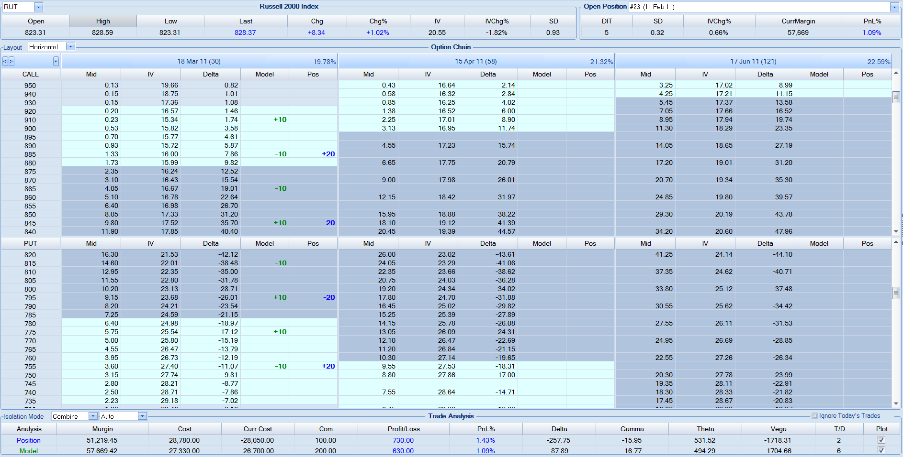
Rolling

Slide 8
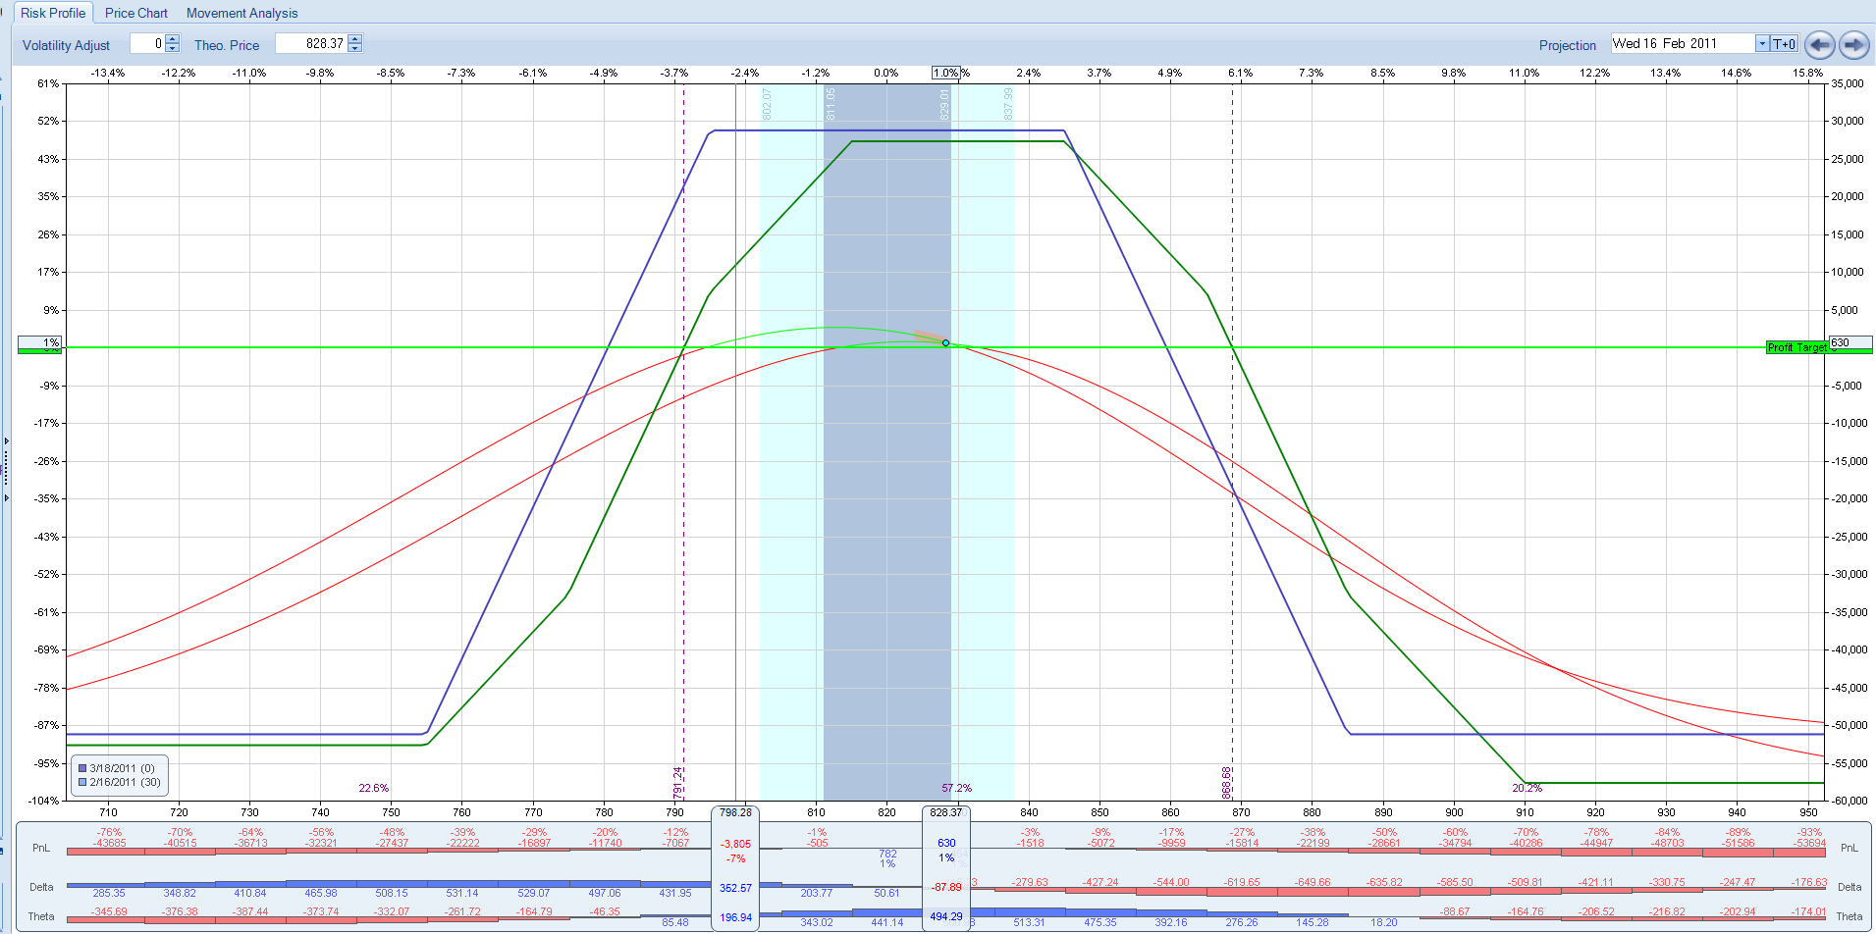
Rolling

Slide 9
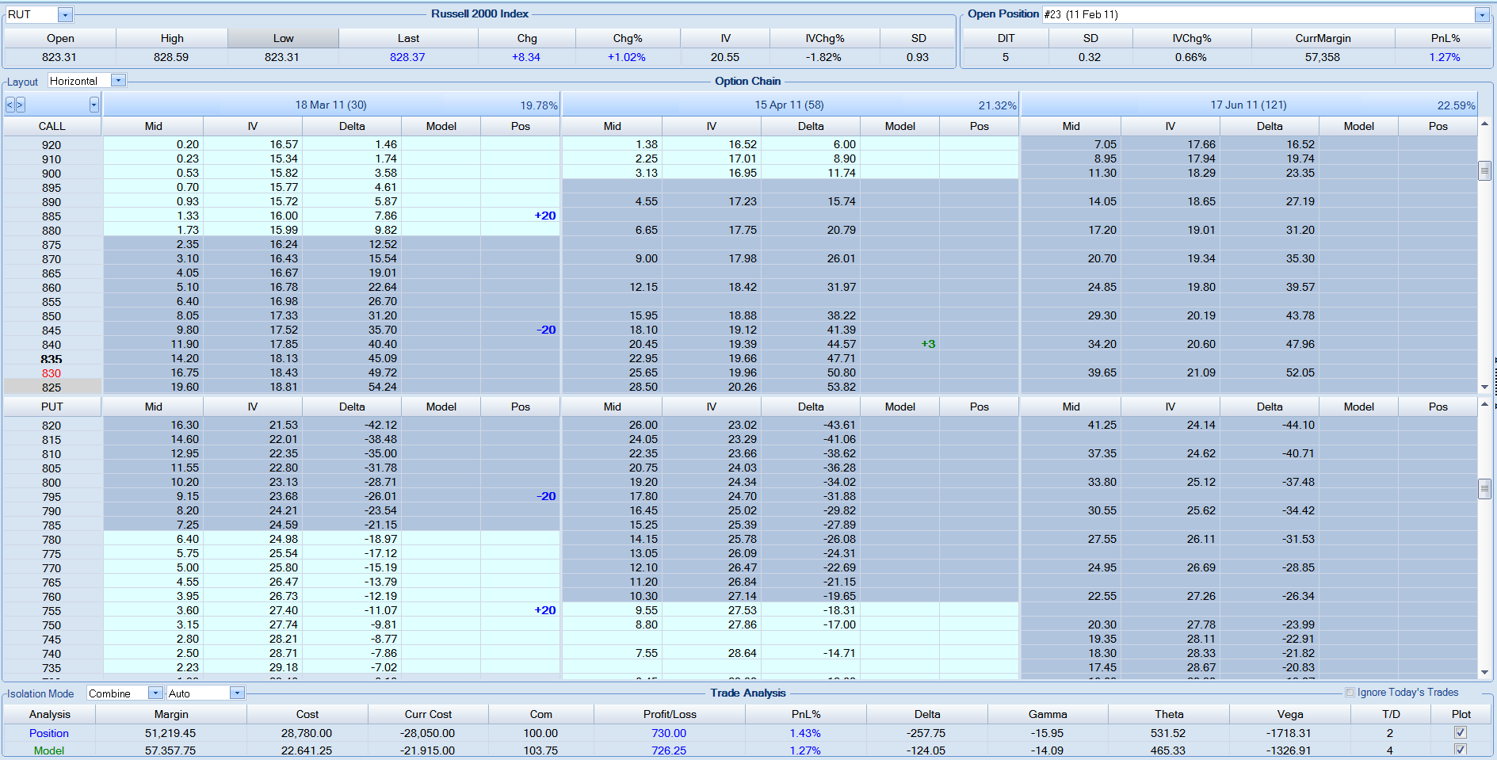
Buy a Long

Slide 10
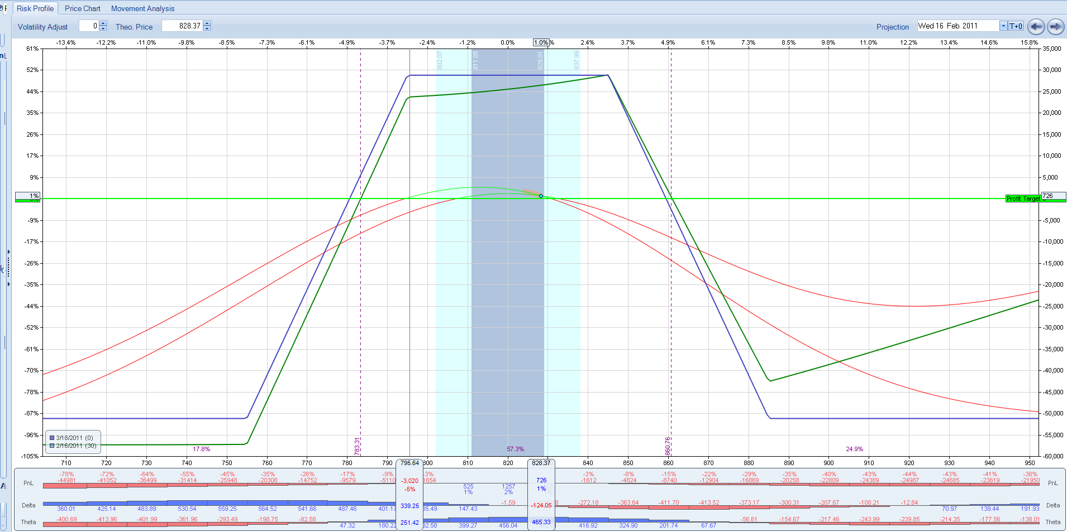
Buy a Long

Slide 11
Adjustments (12-14 DTE)
Condorize trade if original position has been rolled.
If already condorized, can peel off some of the shorts to flatten T+0 line, or
Move shorts on threatened side closer to longs &/or move longs on good side closer to shorts (improves Delta, Theta & reduces margin requirements)
Other adjustment techniques are available
Notes:
Condorizing the trade means rolling the inside short strikes out to the outside short strikes.

Slide 12
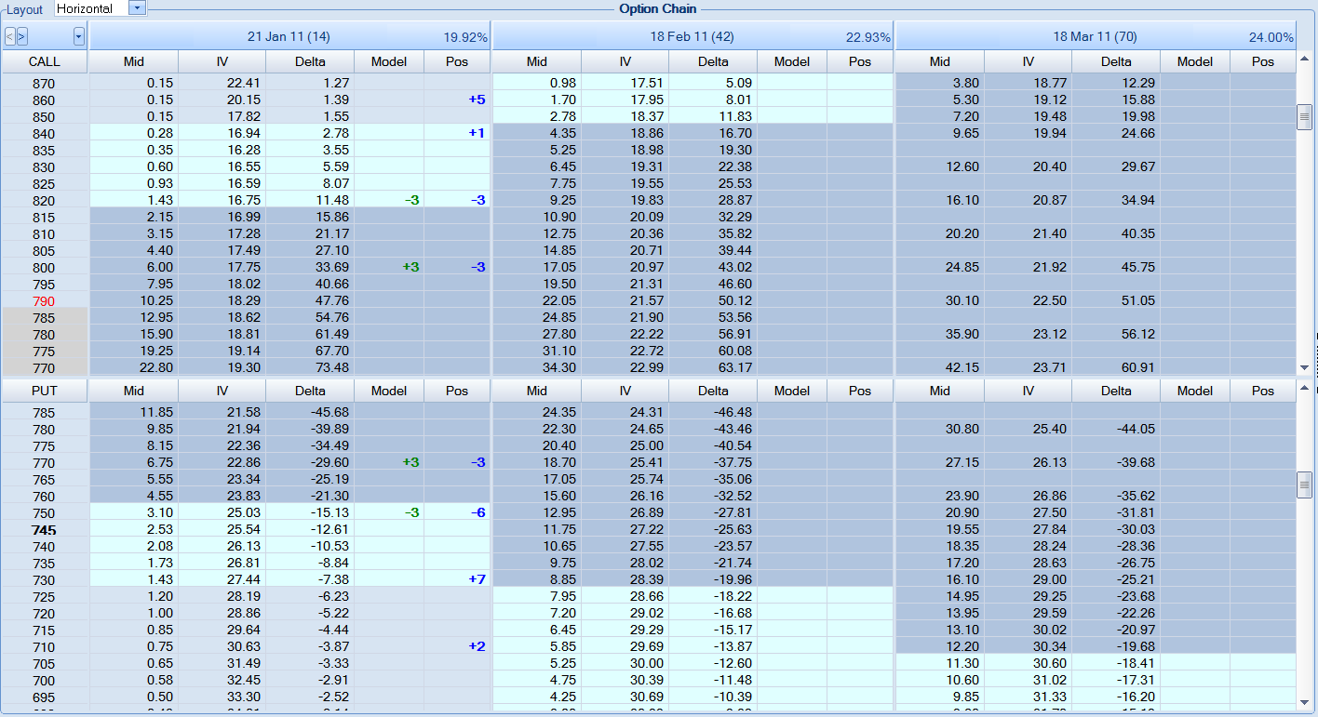
Condorization
Notes:
Reduces Margin, widens BE’s, smoothes the T+0 line for final week of trade.

Slide 13
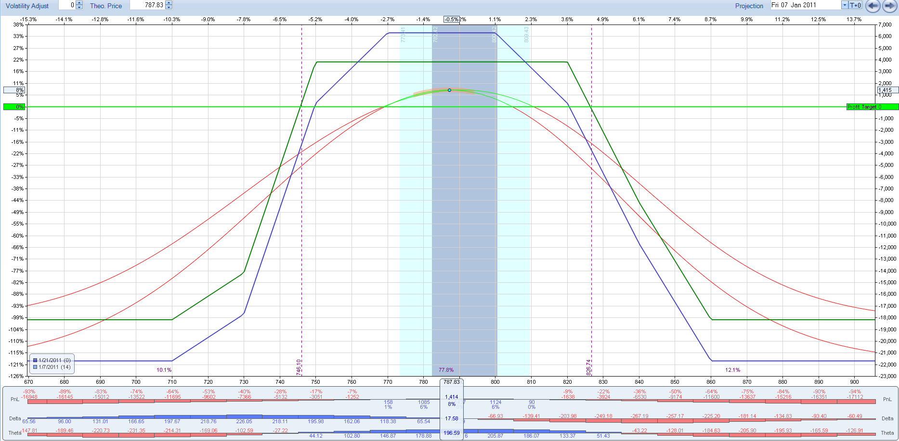
Condorization
Notes:
Reduces Margin, widens BE’s, smoothes the T+0 line for final week of trade.

Slide 14
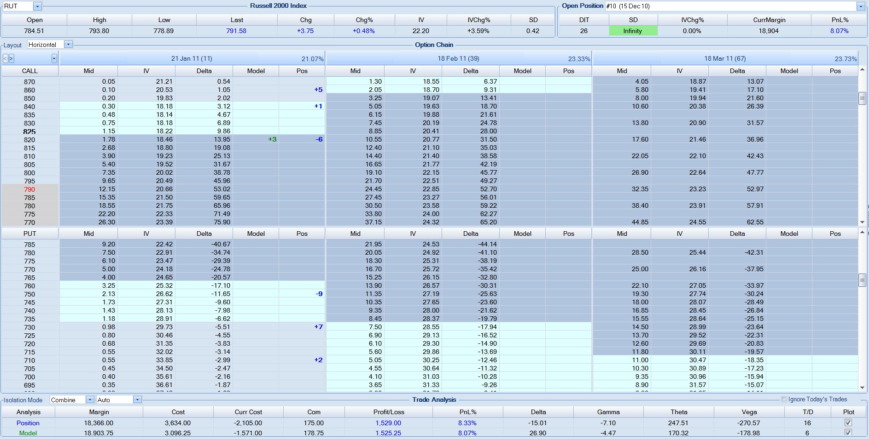
Buy Back Short(s)
Notes:
This widens the BE & flattens the T+0 line on the threatened side. It does cost some capital but it doesn’t impact the T+1 line too much.

Slide 15
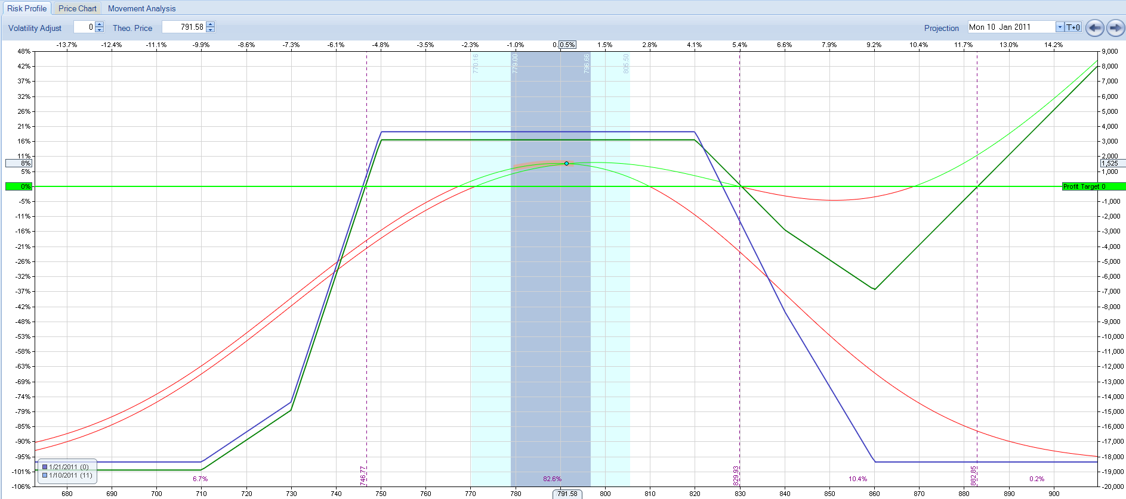
Buy Back Short(s)
Notes:
This widens the BE & flattens the T+0 line on the threatened side. It does cost some capital but it doesn’t impact the T+1 line too much.

Slide 16
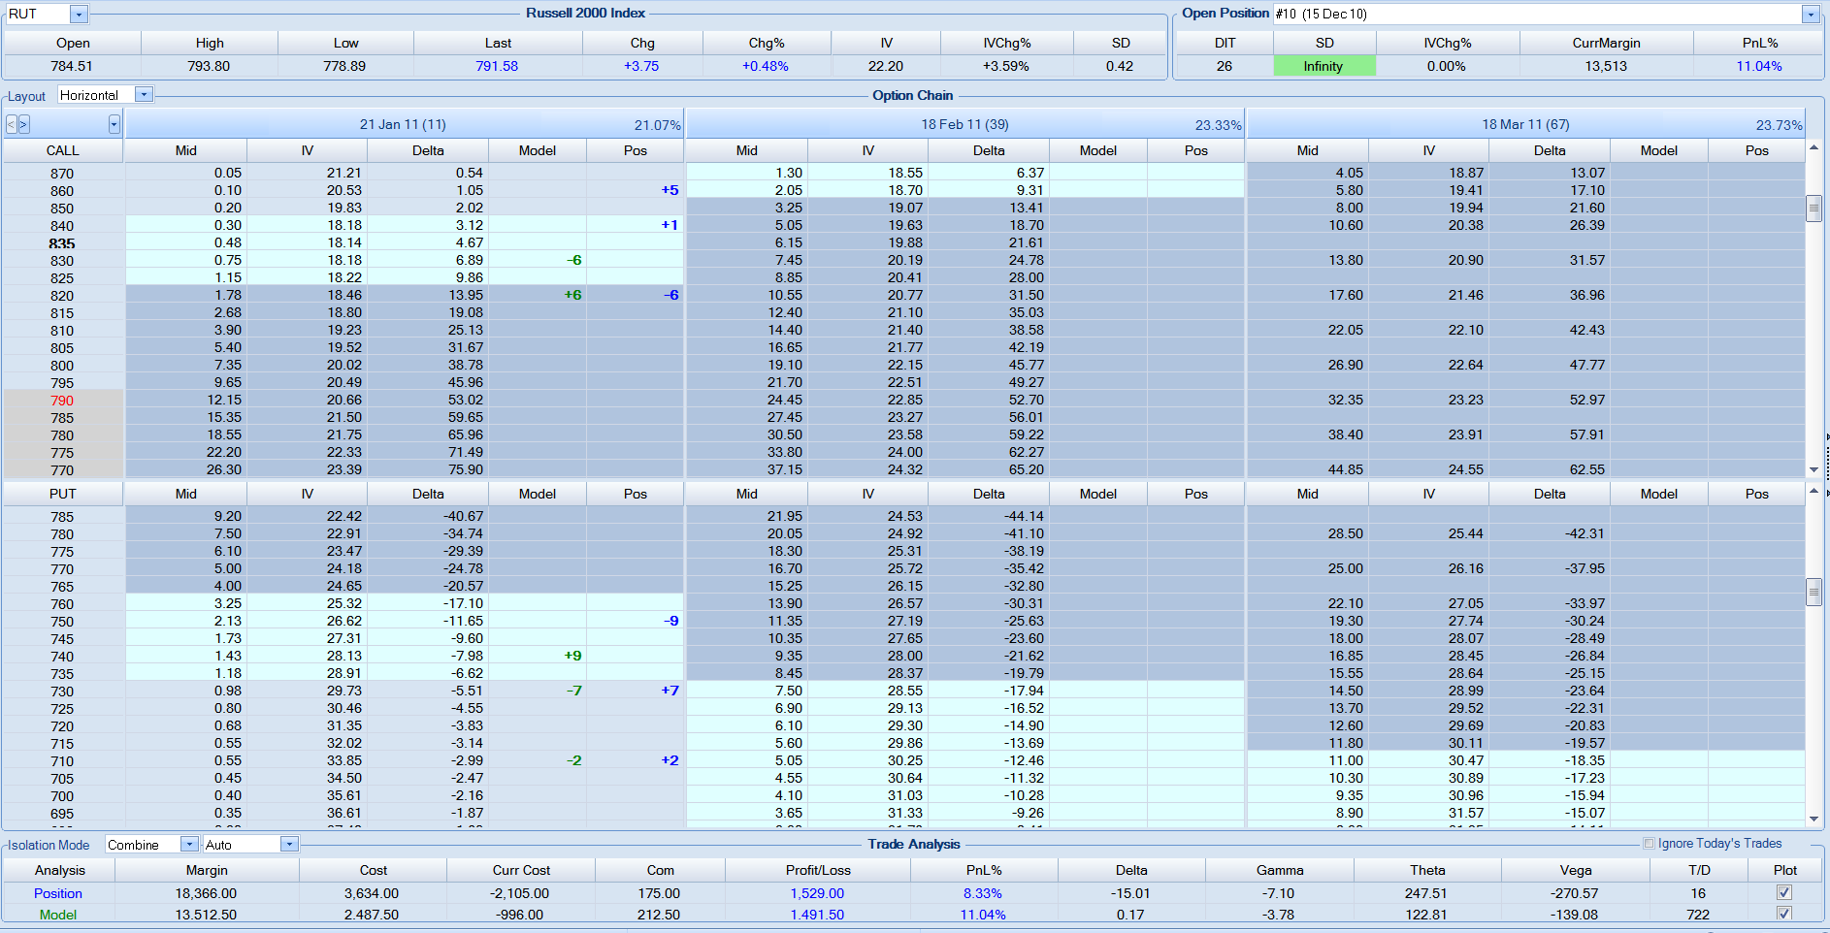
Move Shorts &/or Longs
Notes:
This reduces margin significantly, widens the T+1 line and flattens the T+0 line.

Slide 17
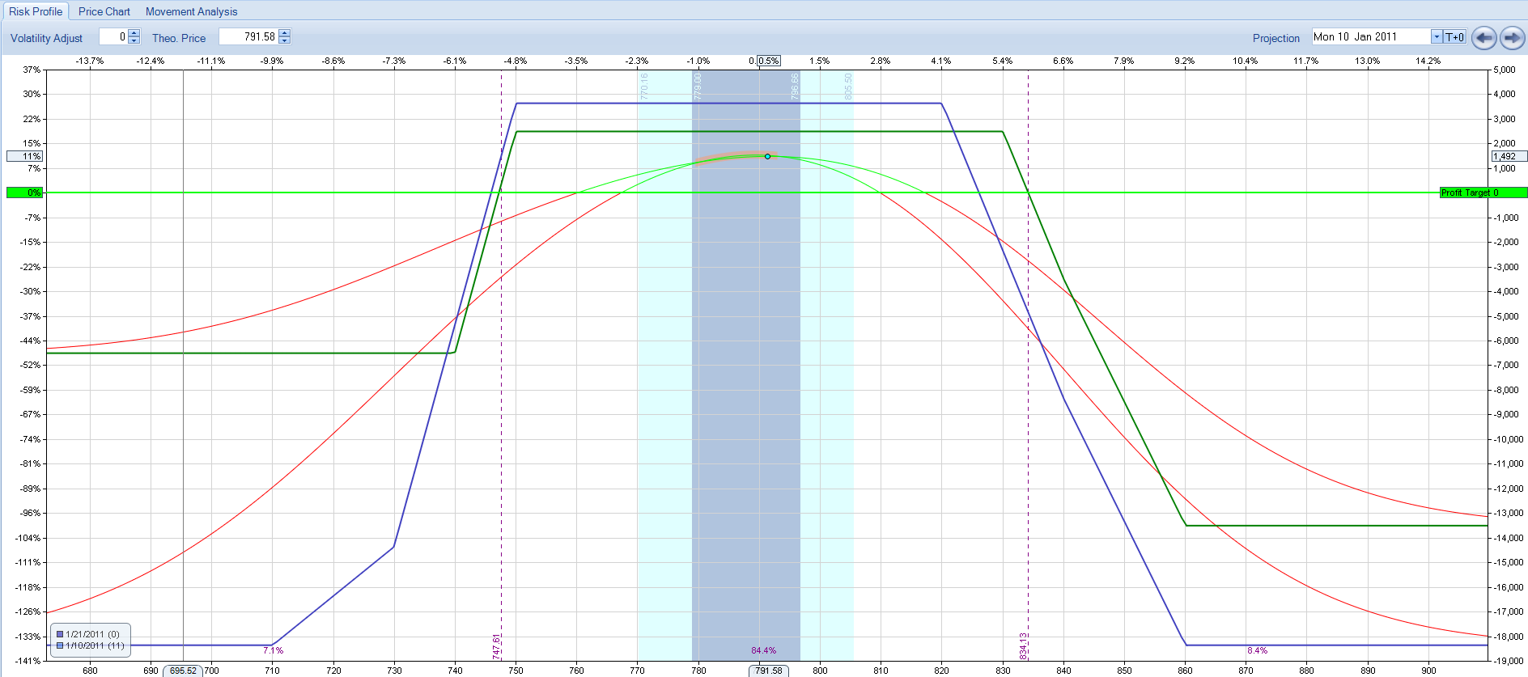
Move Shorts &/or Longs
Notes:
This reduces margin significantly, widens the T+1 line and flattens the T+0 line.

Slide 18
Results
Month | Desc | Margin | P/L | ROI
Jun | -3 - 30 Wide | $15,374 | -$1,572 | -10.2%
Jul | -3 - 30 Wide | $13,388 | $1,172 | 8.8%
Aug | -3 - 40 Wide | $19,083 | -$512 | -2.7%
Sep | -3 - 40 Wide | $16,275 | $2,087 | 12.8%
Oct | -6 - 40 Wide | $42,579 | $2,694 | 6.3%
Nov | -10 - 50 Wide | $28,443 | $2,450 | 8.6%
Dec | -10 - 50 Wide | $27,834 | $2,260 | 8.1%
Jan | -10 - 50 Wide | $25,470 | $2,955 | 11.6%
Feb | -15 - 50 Wide | $45,145 | $5,775 | 12.8%
Mar | -20 - 50 Wide | $53,432 | $5,138 | 9.6%
Apr | -20 - 50 Wide | $50,193 | $5,130 | 10.2%
Notes:
The first column is the expiration month
This is the profit from my first Apr Expiry RUT trade, which I started on Mar 10. I closed this trade on Mar 15 with the profit shown. On that same day I opened another RUT trade. I could have kept the original trade open and managed it to a higher profit, but, you can’t go broke making a profit. At this point, because I am retired, I’m making sure I make my profit goals to insure a minimum level of income. Everything after that I consider speculation.
Jan Expiry – in trade from Dec 15 to expiry Feb – in trade from Jan 19 to Jan 27 Mar – in trade from Feb 11 to Mar 7 Apr – in 1st trade from Mar 10 to Mar 15

