Slide 1
How I Trade Crude Oil
    Hare Krishna Mitra
    OC TRADERS
    6/16/1012

Slide 2
TRADING DISCLAIMER
All TRADING involves high risk and YOU can LOSE a substantial amount of money, no matter what method you use. All trading involves high risk; past performance is not necessarily indicative of future results.
Commission Rule 4.41(b)(1)(I) hypothetical or simulated performance results have certain inherent limitations. Unlike an actual performance record, simulated results do not represent actual trading. Also, since the trades have not actually been executed, the results may have under- or over-compensated for the impact, if any, of certain market factors, such as lack of liquidity. Simulated trading programs in general are also subject to the fact that they are designed with the benefit of hindsight. No representation is being made that any account will or is likely to achieve profits or losses similar to those shown.

Slide 3
Trading is a Mental Game
80% psychological
14% money management
5% techniques
1% luck

Slide 4
4`E`s of Trading
Eyes
Emotions
Entries
Exits

Slide 5
How do I trade
Buy low & Sell High
Sell High & Buy low
Buy Strength
Sell Weakness

Slide 6
Trading Methodology
Follow the Trend
  Buy a higher low
  Sell a lower high
Be on the right side
  You must have a lower low on your left while buying
  You must have a higher high on your left while selling
Always use Stops
  Should not be too close
  Ideally should be below the left side low for long trade and above the left side high for short trade

Slide 7
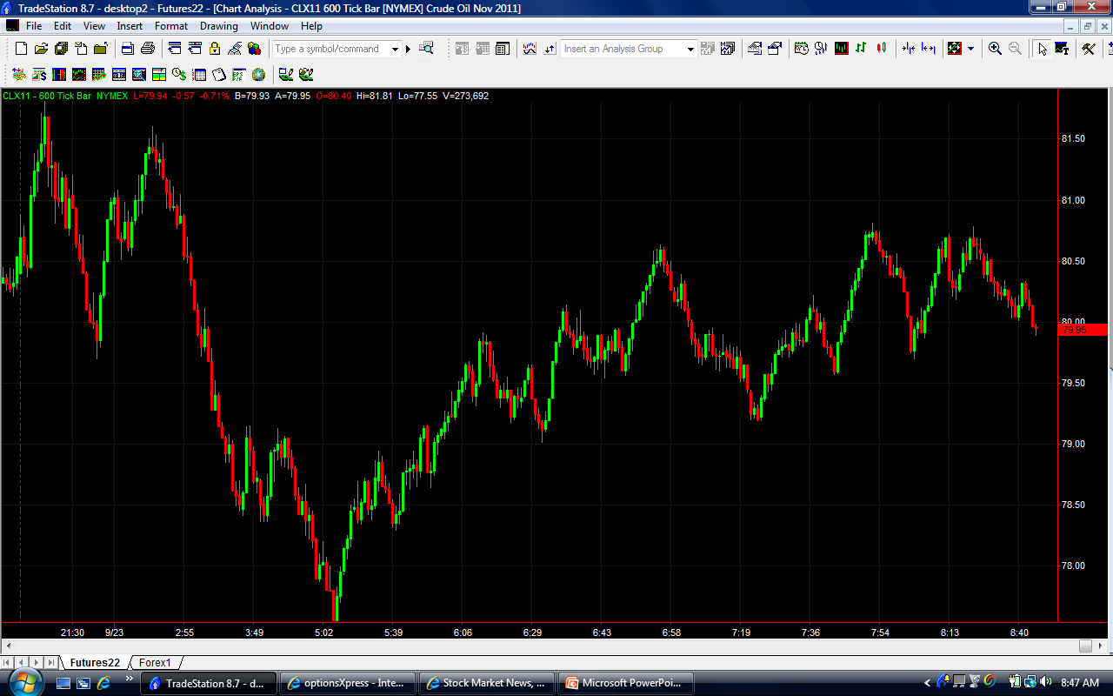
Keep It Simple

Slide 8
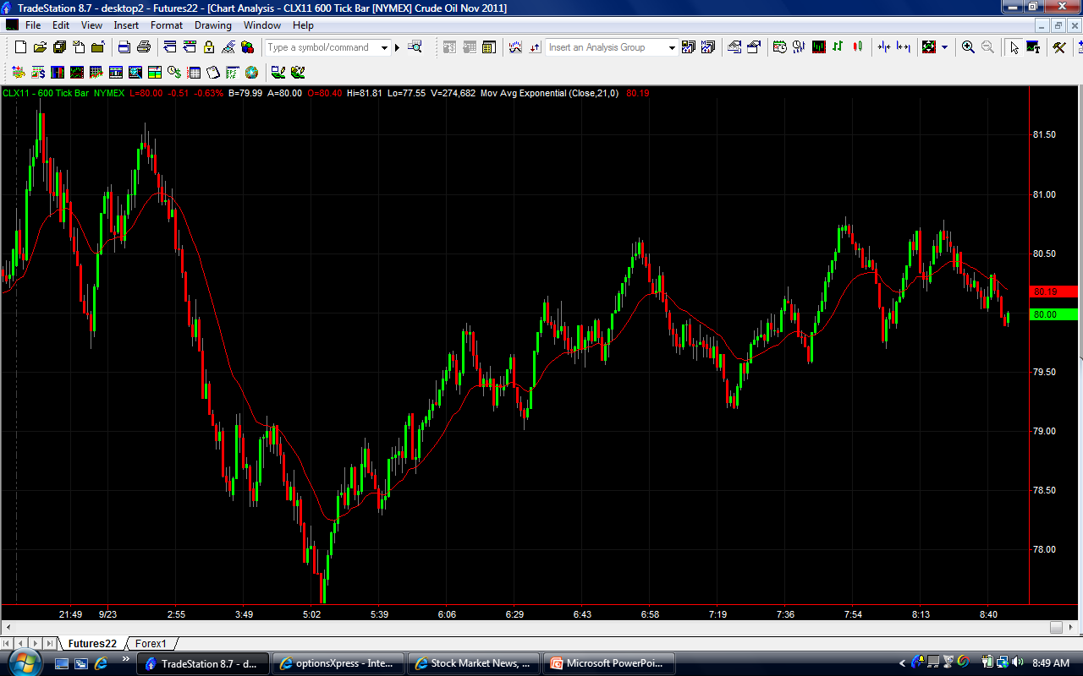
Adding Complexity

Slide 9
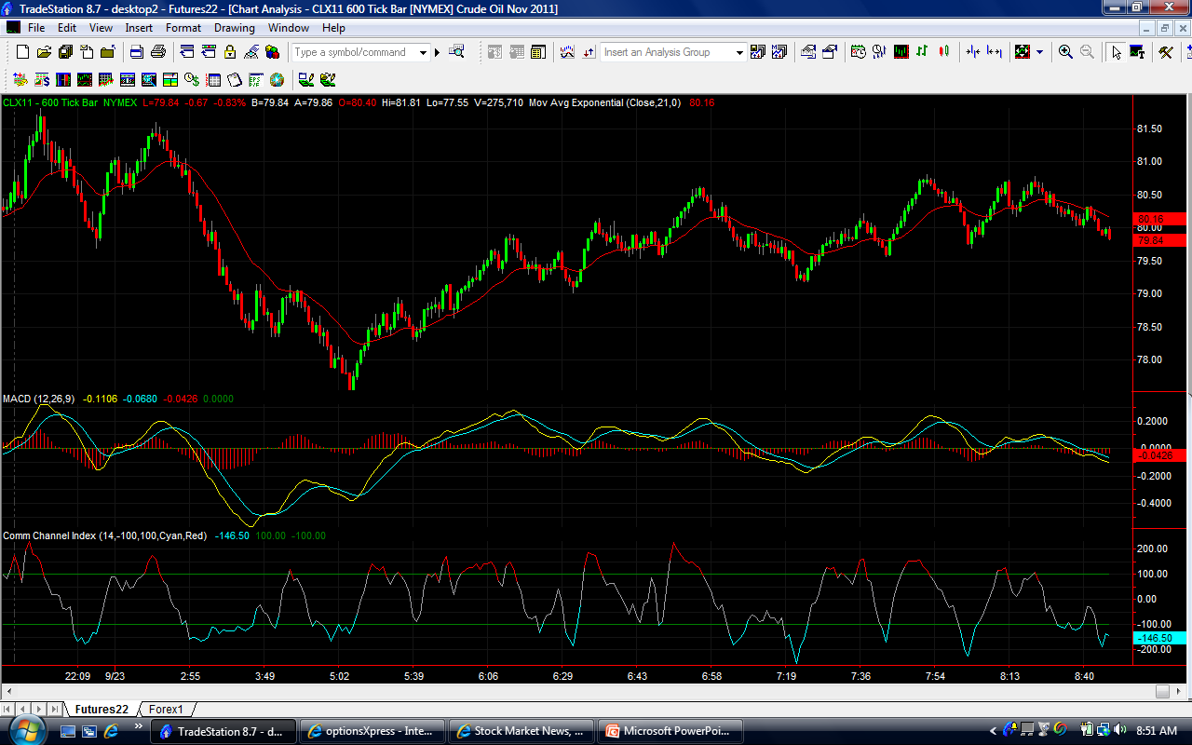
Adding More Complexity

Slide 10
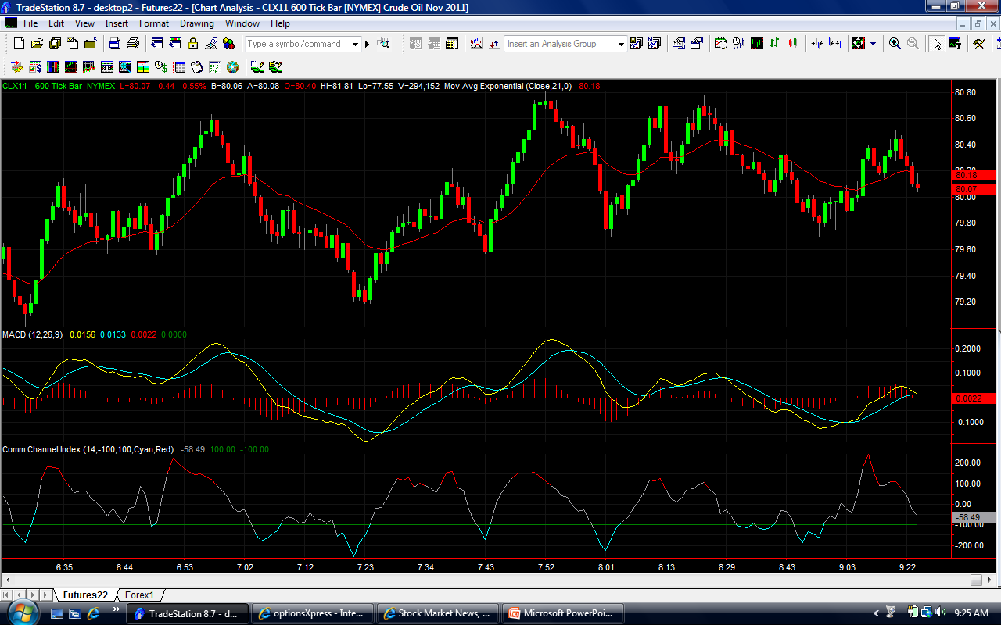
Price & Oscillator Divergence

Slide 11
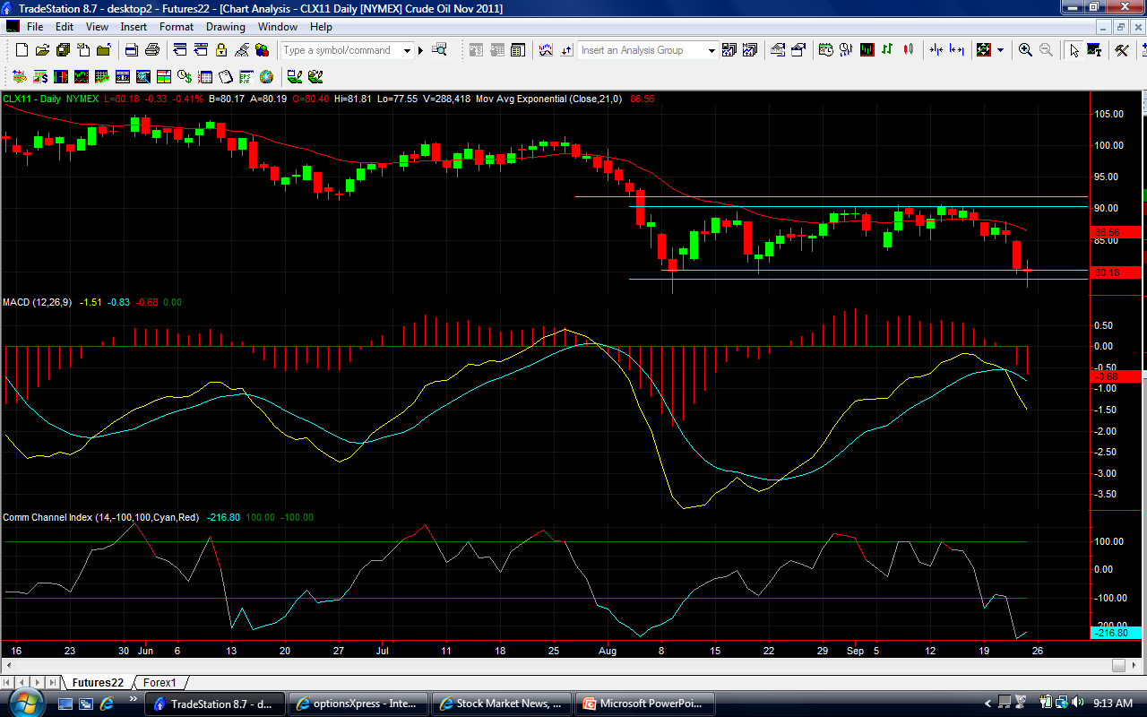
Buyer & Seller Concentration
(BCA & SCA)

Slide 12
Trading is like Driving a Car
Look through the wind shield
  Look at the chart you want to trade from (Intraday decision making chart)
Look at the rear view mirror
  Look at the long term chart (Daily)
Look at your left mirror
  Look at a relatively longer term chart compared to the decision making chart
Look at your right mirror
  Look at a shorter time term chart

Slide 13
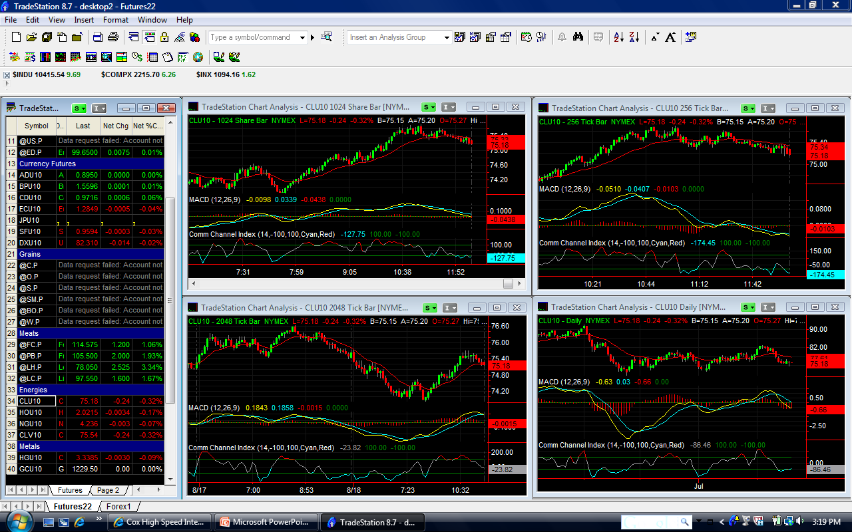
Mitra’s Quad Screen Trading System
QSTS

Slide 14
Good Luck & Good Trading

