Slide 1
ADX Indicator
AKA: “Wilder’s DMI”-Directional Movement Indicator
Presented by Judith Segura-Mora (Info. Source: stockcharts.com)
By PesenterMedia.com

Slide 2
ADX (+DI/-DI )
THE AVERAGE DIRECTIONAL INDEX
  -Works well to help us identify a strong trending market.
  -It is a TWO part trading system:
ADX INDICATOR:
AD LINE=
Advancers-Decliners
Directional Movement
+DI/-DI

Slide 3
J. Welles Wilder
-Creator of ADX
  Wilder, a technical chartist, is famously known for also creating other widely used indicators such as RSI, ATR, and the Parabolic SAR system.
  Wilder features this Directional Movement indicator in his 1978 book, New Concepts in Technical Trading Systems. Despite being developed before the computer age, Wilder’s indicators are incredibly detailed in their calculations and have stood the test of time.

Slide 4


AD LINE
Advance/Decline Line
Practical Explanation:
    The Advance Decline Line is THE BLACK LINE, which indicates momentum, or strength of the trend. 20-25 is key level !
INFORMATION SOURCE:
This AD line is a breadth indicator based on Net Advances, which is the number of advancing stocks less the number of declining stocks.
Typically the advance-decline statistics come from the NYSE or Nasdaq on a daily basis. The Nasdaq tends to have a lower trending bias due to it’s volatility. The AD line should confirm an advance or decline with similar movements on the indexes.

Slide 5
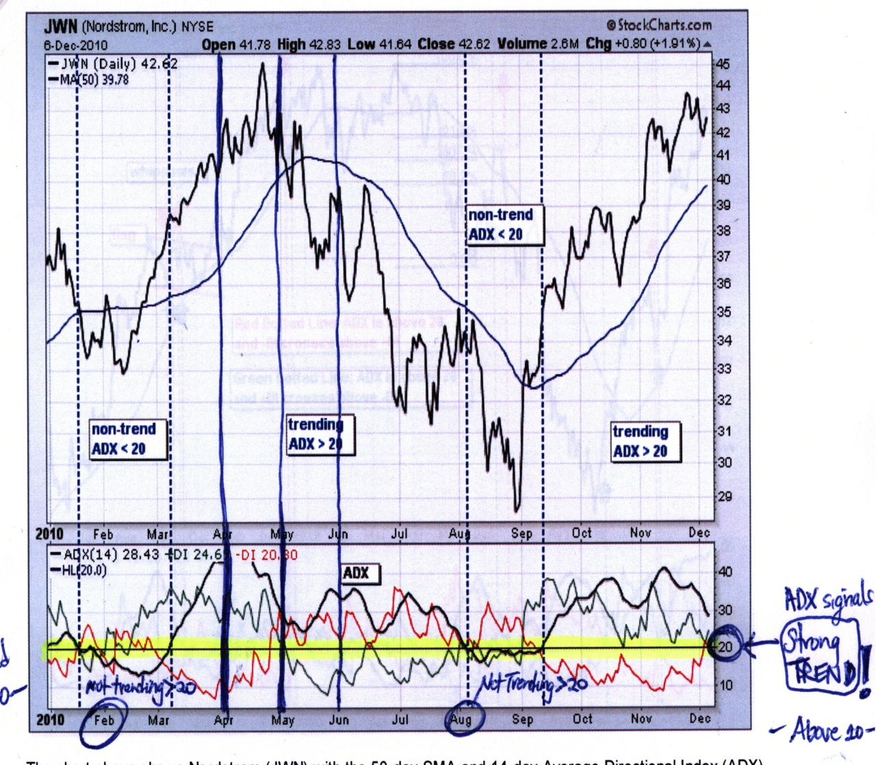
-DI/+DI
*Minus & Plus Directional Indicator
PLUS AND MINUS
DIRECTIONAL
MOVEMENT IS THE
BACKBONE OF THE ADX.
-WILDER DETERMINED DIRECTIONAL MOVEMENT BY COMPARING THE DIFFERENCE BETWEEN TWO CONSECUTIVE LOWS AND THE DIFFERENCE BETWEEN THE HIGHS. He suggested above 25 bullish, yet most chartist, suggest above 20.
-A BUY SIGNAL:
+ DI crosses above –DI
-A SELL SIGNAL:
- DI crosses above +DI

Slide 6
Trending System (Buy & Sell Signals )
-ADX is not good for oscillating markets
Basic 10 Day-50 Day System:
Criteria for Bullish Trades:
A. $bpcompq is uptrending (stockcharts.com)
B. 10D EMA crosses over 50D EMA
C. MACD crosses above zero line
D. ADX –Green above Red with black line moving upward
E. Watch Intra-day High Low on Candles
Candle Highs & Lows
Cross-Overs (EMA & ADX, MACD)
Bullish Trend

Slide 7
CHART EXAMPLE (Using Stockcharts.com)

Slide 8
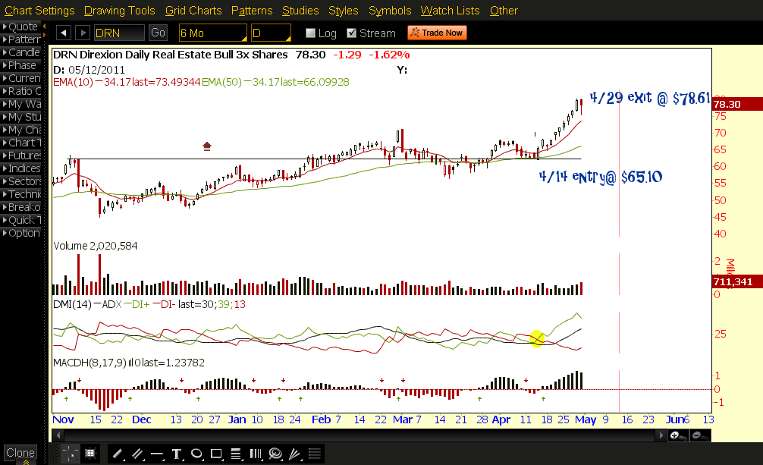
CHART EXAMPLE (Using Thinkorswim.com)

Slide 9

CLOSING THOUGHTS:
All indicators describe post-market activity, and therefore lag in the information they provide us. The fact that every moment is unique in the markets, should warn us that no indicator can fully predict future market action. The ADX in particular has a smoothing technique for eliminating whipsaw action, but it also delays in providing real time information. Indicators can only assist us to filter out the noise, and if used in combination with other criteria, they can be very powerful in allowing us to focus on expected probable outcomes.

